Slide 1
Name
Design and Technology Coursework (8552)
Mr Sewell
Centre number: 52231
Candidate number:
Year: 2019-20

Slide 2
What I will be expecting from you by the end of today’s lesson
Front cover in folder.
An idea of which NEA title you are choosing (remember, at this point you do not need an idea, just a general direction/problem you would like to solve).
A plan of what your first two pages are going to include.
To have started your first page.
Tips:
Remember to show off your best work – this is about quality not quantity. The content of your writing is the main thing that is marked. Do it right first time so there is less re-drafting.
Ask for help. I am allowed to show you examples of certain pages and give advice, so use me.
Fill the pages up. No gaps. Use size 10 font. 20 pages sounds like a lot but it will be hard to get all your content, research, drawings, etc included.
Make the most of your time, especially now. Life gets busier as you go towards the end of year 11.

Slide 3
Page tips
Keep your titles all the same size/font.
Keep your main written work all the same size/font (max 10).
Give each page a simple border.
No marks for this stuff so do not take ages doing titles/borders etc.
Use exemplar folders if you are stuck on what content to put on pages.
Add 20 pages along the side.

Slide 6
Timing
Research, design brief, and specification complete before end of year 10.
Start initial ideas over summer holidays. Complete them if possible.
Finish design ideas/start development in September.
Start making end of November latest.
Evaluate end of February latest.
You should be completing 1 page every two weeks to stay on track.

Slide 8
Stating and analysing the problem – do this in as much detail as possible!

Slide 9
What to think about
What is the problem?
Facts/statistics about the problem.
What solutions are already out there?
Where does this problem happen?
Why is there this problem?
Where can you go to find out about this problem?
Where would your product be used?
Who does the problem affect?
When would this product be used?

Slide 10
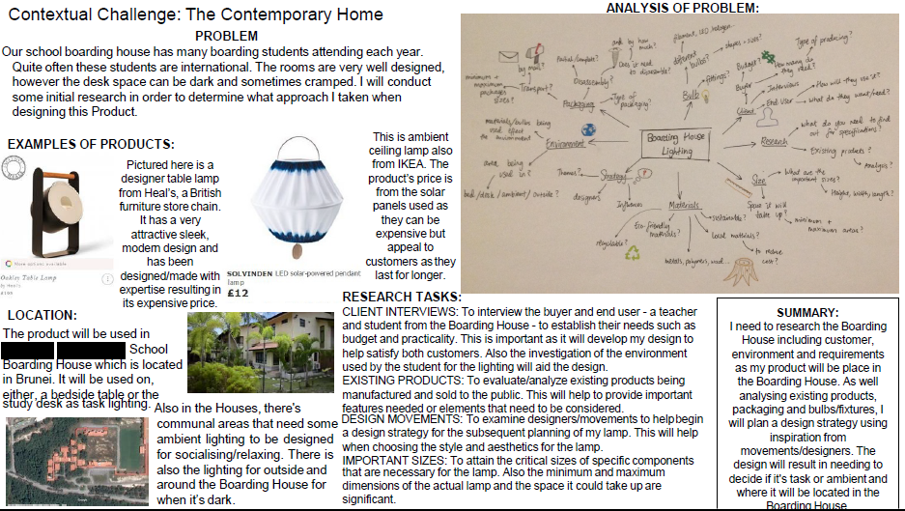
Analysing the problem

Slide 11
Things to think about
Target market profile:
Who is the person you are interviewing? Age, gender, salary, hobbies. Why did you pick this person?
Use open ended questions.
Location analysed:
Where is the product going to be used? Do you have space limitations? What are the main colours and styles in that area? Are there any dangers to consider? What type of surface does your product sit on or hang from? How do these things affect the design of your product?
Summarise what you learnt at the end of the page. How do these answers affect your designing?

Slide 12
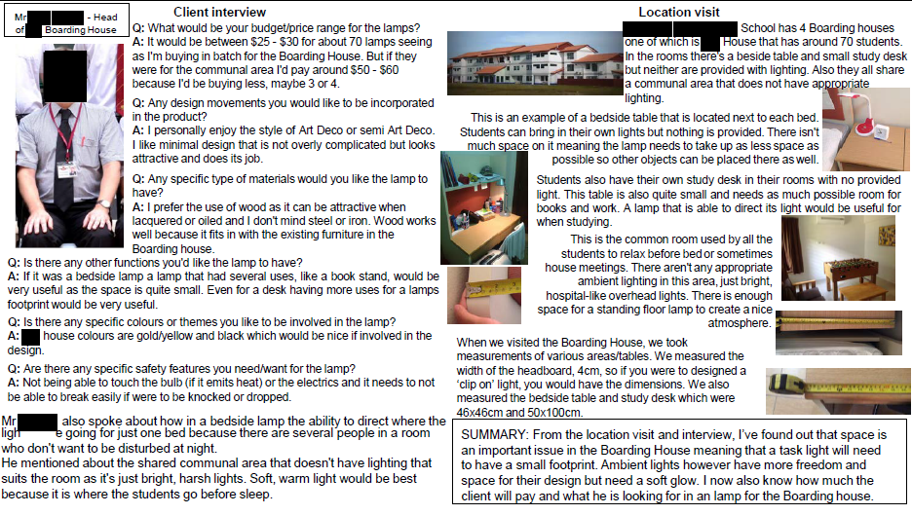
Target market analysed and location analysed

Slide 13
Product Analysis - what to think about
Don’t say ‘The cost is about….’ Do say ‘The cost is……’
Have I analysed everything eg: Don’t just say the cost. Is that price reasonable – why? How much would it be in materials? Could you think of a way of making it cheaper? Would this price suit the target market? Eg: Teenagers do not have much money.
Conclusion - summarise the main points of the page at the end.
Have you got lots of pictures of the product and are they a reasonable size so you can see the details of the product?

Slide 14
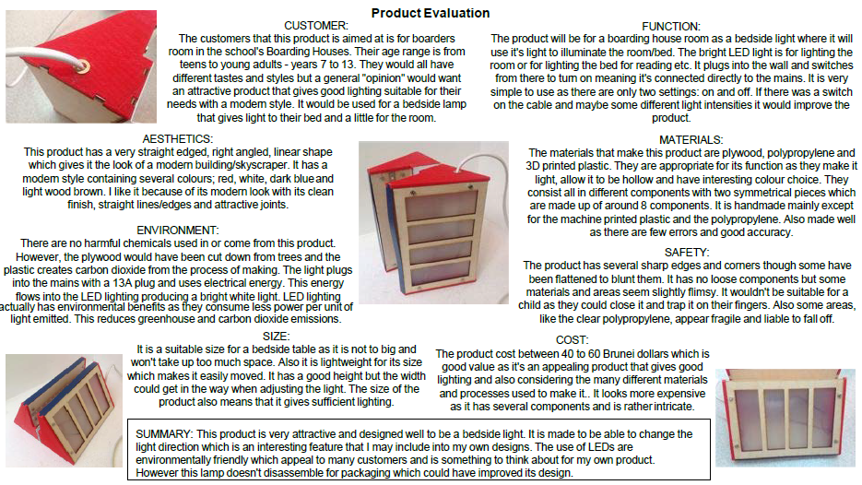
Product Analysis example

Slide 15
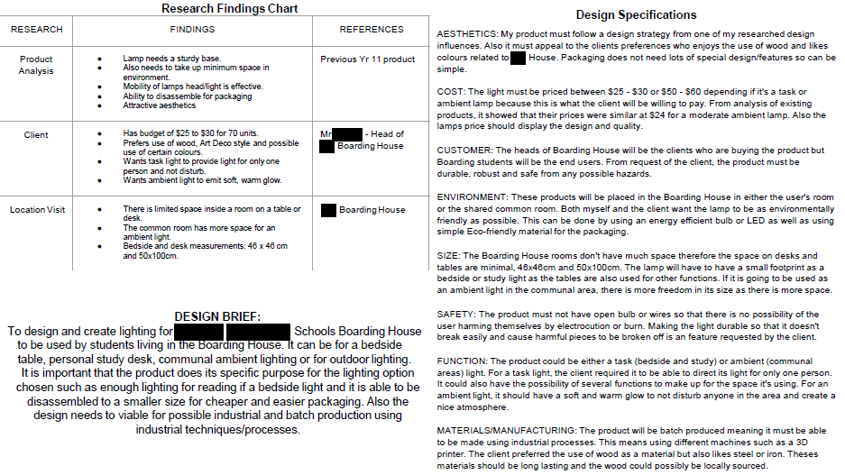
Design brief and specification page

Slide 16
Writing a design brief and specification
What is a design brief? Break up the phrase.
Go back to your first page – have you been too specific too early? Remember your first page should talk about the problem, not a solution. If you have made this mistake do not delete large chunks of writing – maybe you can just move it to your design brief.
In your design brief you are now talking about the solution. Briefly – what are you going to design (but do not be too specific yet – don’t say actual colours, dimensions etc). It normally starts with ‘I am going to design and make a……’.
What is a design specification – break up the word?
Points should be measureable. What does this mean?
You could think about the use of the words ‘must’, ‘should’, ‘could’. What is the difference?
Why have you stated this point? Has your research findings made you come up with this point?
Justify each point. Eg: why have you chosen these measurements?

Slide 17
Initial ideas mark scheme
How can we score high?

Slide 18
Quick fire ideas!
You have 3 minutes to sketch 3 ideas on 3 post it notes.

Slide 19
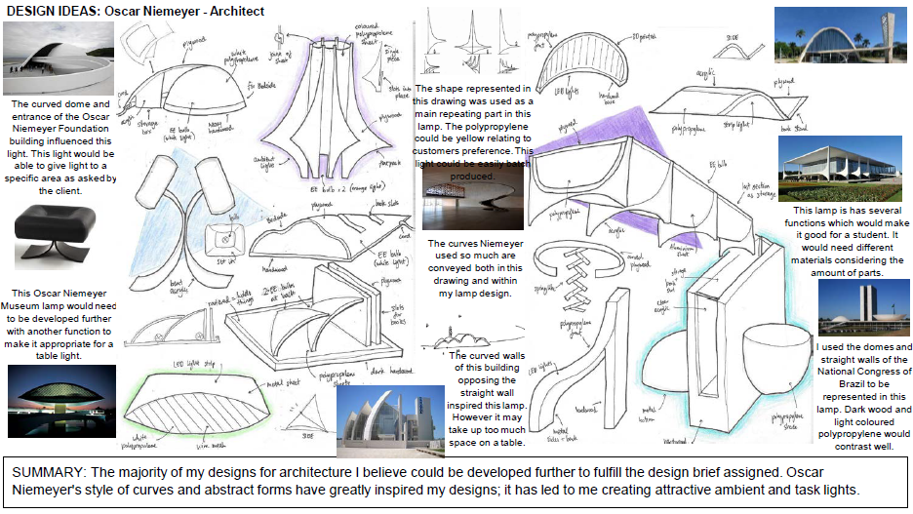
Great initial ideas pages

Slide 20
What did they do well?
Client opinion
Creativity
3D sketches. Different views could help explain idea further.
Using existing designers work as inspiration (this could have been done in more detail – this is in the mark scheme!)
Annotation: Use ACCESSFM for ideas on what to analyse. Relate back to specification. This person used lots of 1/2/3 word annotation. Not good! Paragraphs are better.

Slide 21
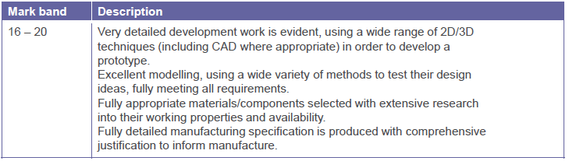
Development – what can it include?
Prototypes/models
Sketches of your product developing (looking at every detail) up to drawings of your final design.
CAD drawings
Testing certain parts full size
Extended research into materials/components/ anthropometrics etc
A manufacturing specification.

Slide 22
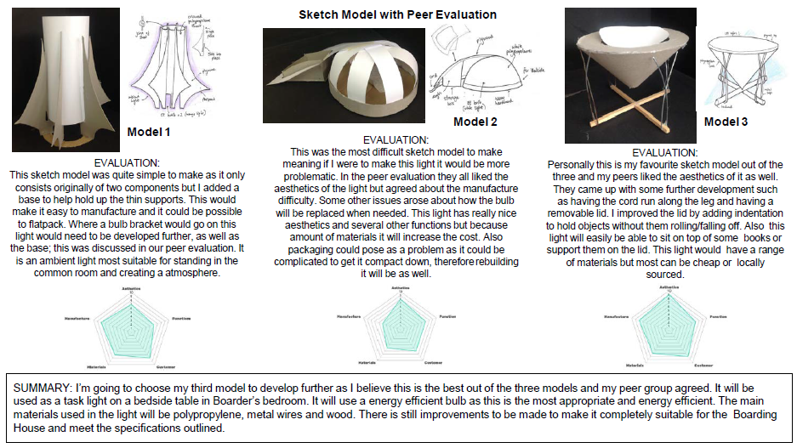
Development – model/prototype making

Slide 23
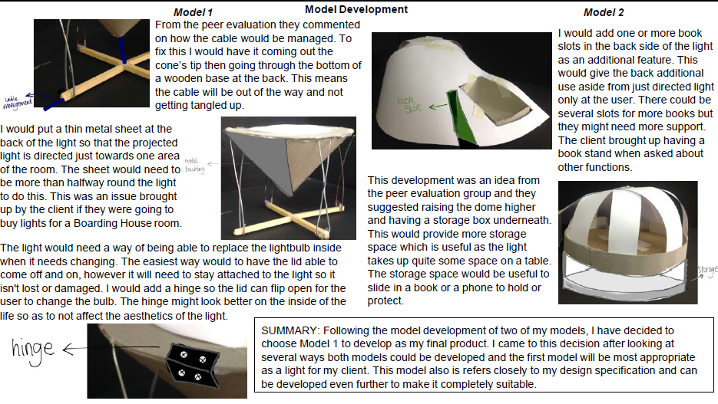
What did they do well?
3 ideas have been modelled with two pages to analyse them.
Good evaluation of each modelled idea. ACCESSFM can help you here.
The use of writing and drawing (on photographs) demonstrates how idea can be improved. You can also do separate sketches to show what an improved version will look like.
A good set of summaries summarising the task and what has been learnt.
Asking client/target market their opinions of your prototypes.
And what could be improved:
A few more photos could improve these pages.

Slide 24
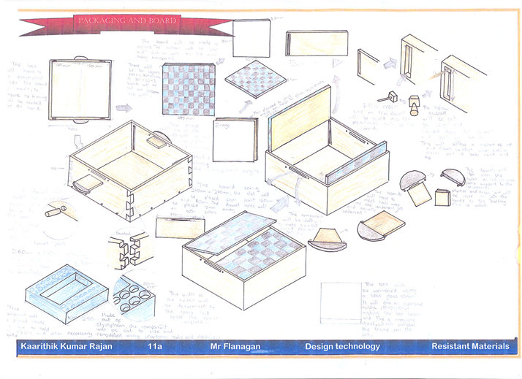
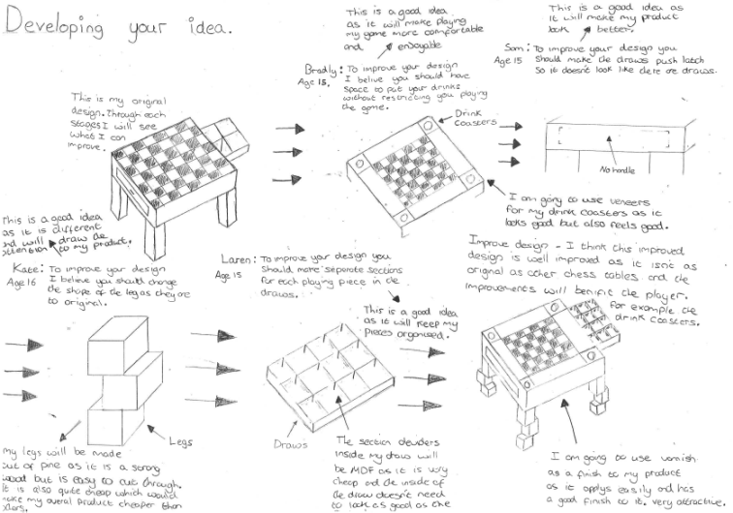
Development sketches up to your final design
There should be a story of how your initial ideas developed into your final design. Sketches are a good way to do this.
Bad development is when an initial idea suddenly becomes a final idea with no reasoning to why it is formed/coloured/functioning that way, and certain materials and components selected with no reasoning. Every decision should be reasoned and evaluated.

Slide 25
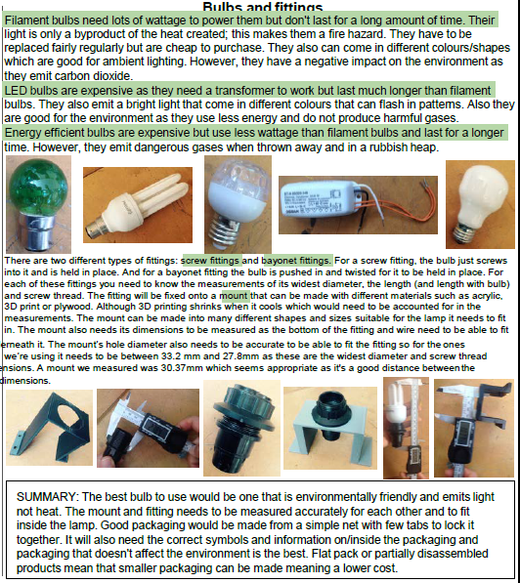
Extended research
Now you have a better idea of exactly what you are making, you may need to find out information on anthropometrics, dimensions of objects, what materials/ components are best suited to your product etc.
Remember to analyse all this information thoroughly with pictures.

Slide 26
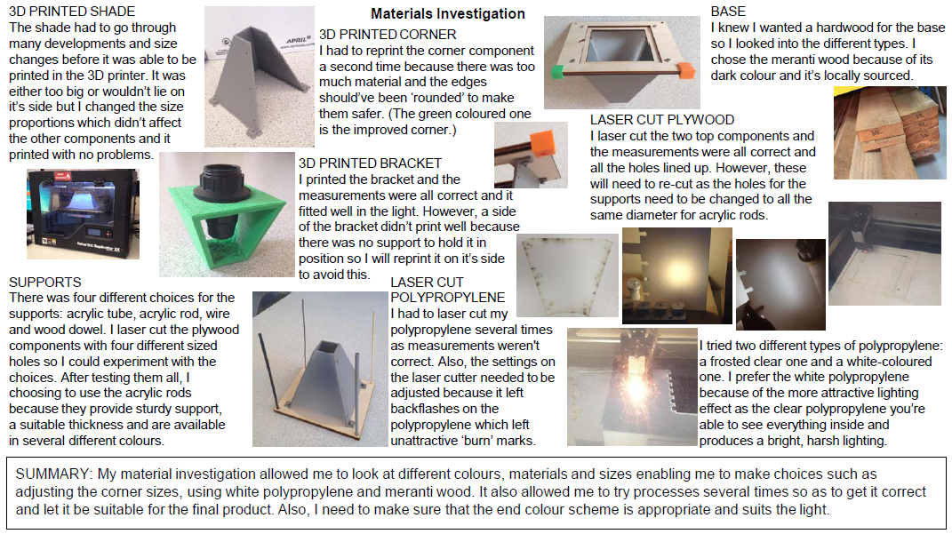
Full size testing of parts
Have a practice of the really challenging parts of your product before you make it. Take pictures and evaluate how well the test went and how you might improve that part on your final product.

Slide 27
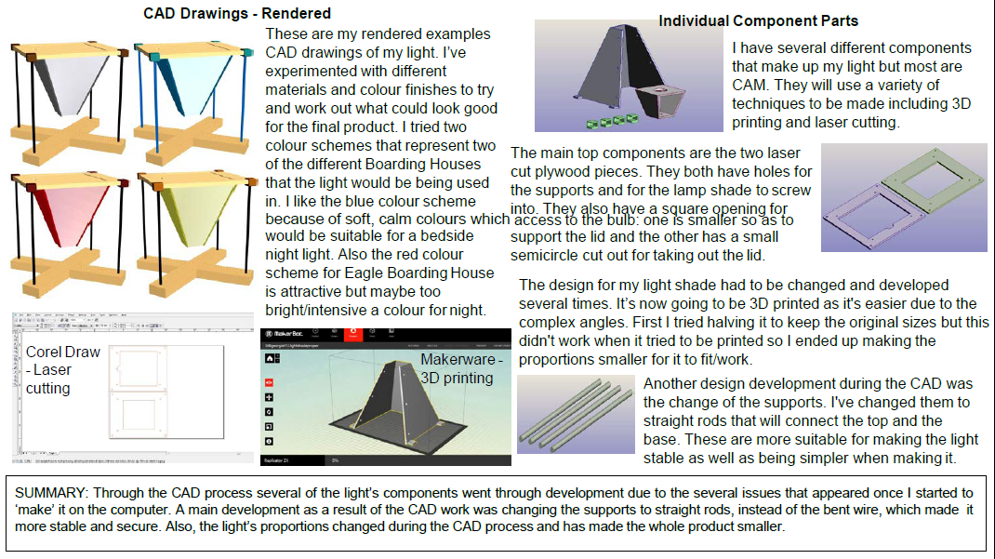
Show off your CAD skills
This could be Solidworks, Google Sketch-up, 2D Design, Fusion 360. Have a go!

Slide 28
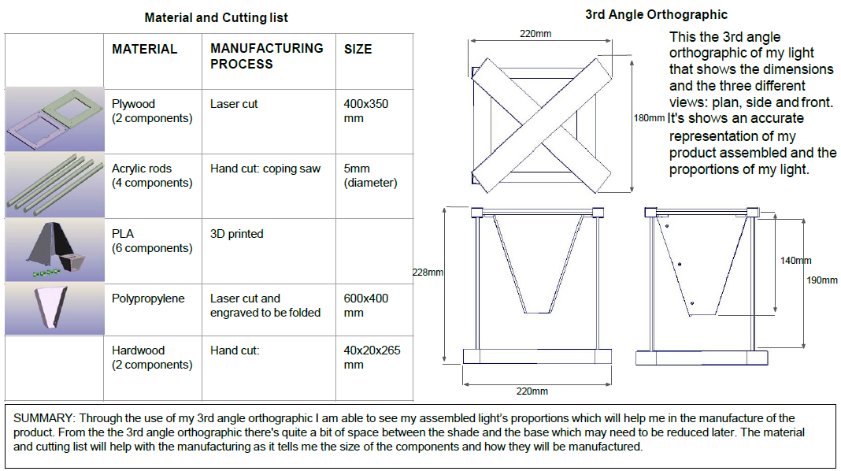
Cutting list and Orthographic drawing with measurements
This page makes up a ‘manufacturing specification’.

Slide 29
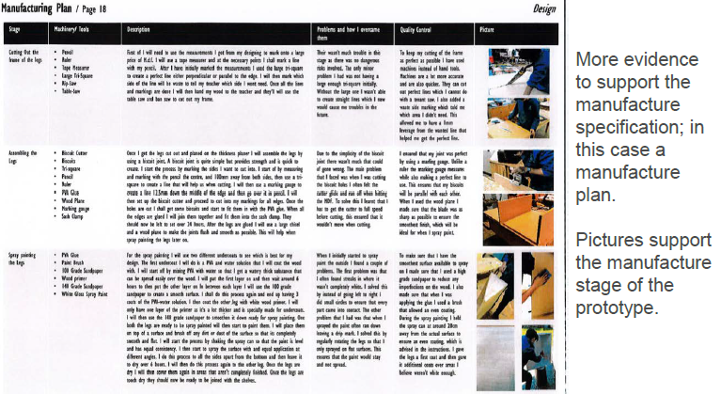
Manufacturing PLAN (not record)
This is a continuation of your ‘manufacturing specification’.

Slide 30
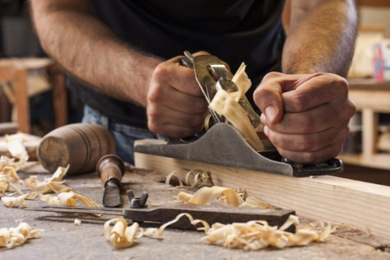

Making your product
It sounds obvious but you need to make sure your product works and is full size. This can only really be guaranteed through the testing stages of your development.
Time is your enemy. So here are a few tips for shaving off valuable hours:
Make sure you practice the difficult bits first. Remember you get lots of marks for recording failures in your development section.
Keep in mind that you will fail many times. Do not expect everything to go right first time because it will not.
Use a cutting list. Get the technician to do as much cutting for you as possible as he can sometimes use more time efficient and accurate machines.
Fail to plan, plan to fail. Plan everything ahead of time. Do not turn up to lessons and then think of what you will do that day. Have at least 3 jobs planned for a lesson. Sometimes you will be waiting for materials to be cut/delivered, or waiting for a machine or for paint to dry. Have other jobs ready to do.
Everything you do goes towards your final marks so make sure you record the successes as well as the failures. This can be done in development and evaluation pages.
Use me and the technicians. We have made, and helped others make, 1000’s of products so we will usually have an answer to most problems you have.

Slide 31


Year 10 – practicing for the final coursework
We have 2 weeks to practice for the final coursework. This is not much time at all so how can we make use of this time?
Make a scale model
Make part of your product
Create tests that you could use next year eg: wood joints, fabric stitches
Perfect folder pages
Time is your enemy. So here are a few tips for shaving off valuable hours:
Make sure you practice the difficult bits first. Remember you get lots of marks for recording failures in your development section.
Keep in mind that you will fail many times. Do not expect everything to go right first time because it will not.
Use a cutting list. Get the technician to do as much cutting for you as possible as he can sometimes use more time efficient and accurate machines.
Fail to plan, plan to fail. Plan everything ahead of time. Do not turn up to lessons and then think of what you will do that day. Have at least 3 jobs planned for a lesson. Sometimes you will be waiting for materials to be cut/delivered, or waiting for a machine or for paint to dry. Have other jobs ready to do.
Everything you do goes towards your final marks so make sure you record the successes as well as the failures. This can be done in development and evaluation pages.
Use me and the technicians. We have made, and helped others make, 1000’s of products so we will usually have an answer to most problems you have.

Slide 32


Final two lessons tasks/half term homework
Produce a 1 minute presentation demonstrating to the class what you have learnt over the past month. This could be in folder work, practical skills, or subject knowledge. You can use a powerpoint presentation or physical examples if you wish.
Complete the improvement in your coursework folder. Highlight in green your improvement.

