Slide 1
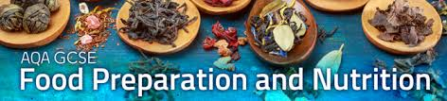




Use this to help you revise for your GCSE exam. There are 6 main topics you need to revise. In this booklet you will find
Exam question command words
Links to online quizzes in student text book
Useful websites
knowledge check questions
Revision complete | Main topic heading
 | Food, Nutrition and Health
 | Food Science
 | Food Safety
 | Food Choice
 | Food Provenance
 | Food preparation and cooking techniques
Name:……………………………………………………………………………………………....

Slide 2
EXAM QUESTION COMMAND WORDS
Command words are the words and phrases used in exams and other assessment tasks that tell you how you should answer the question.
Analyse
Separate information into components and identify their characteristics.
Apply
Put into effect in a recognised way.
Argue
Present a reasoned case.
Assess
Make an informed judgement
Calculate
Work out the value of something.
Comment
Present an informed opinion.
Compare
Identify similarities and differences.
Complete
Finish a task by adding to given information.
Consider
Review and respond to given information.
Contrast
Identify differences.
Criticise
Assess worth against explicit expectations.
Debate
Present different perspectives on an issue.
Deduce
Draw conclusions from information provided.
Define
Specify meaning.
Describe
Set out characteristics.
Develop
Take forward or build upon given information.
Discuss
Present key points about different ideas or strengths and weaknesses of an idea.
Estimate
Assign an approximate value.
Evaluate
Judge from available experience.
Examine
Investigate closely.
Explain
Set out purposes or reasons.
Explore
Investigate without preconceptions about the outcome.
Give
Produce an answer from recall.
Identify
Name or otherwise characterise.
Illustrate
Present clarifying examples.
Interpret
Translate information into recognisable form.
Justify
Support a case with evidence.
Name
Give the correct title or term.
Outline
Set out main characteristics.
Prove
Demonstrate connections between items.
Relate
Demonstrate connections between items.
Review
Survey information.
State
Express clearly and briefly.
Suggest
Present a possible case/solution.
Which
Select or give the correct information.

Slide 3

Use the online textbook to complete a quiz for each main topic to help with your revision
www.illuminate.digital/aqafood
Student Username: SWALTON3
Student Password: STUDENT3
Main topic heading | Quiz Topic & Page number | Quiz Complete
Food, Nutrition and Health | Protein - page 7 Fat - page 16 Carbohydrate – page 21 Vitamins – page 30 Minerals – page 35 Water – page 37 Balanced Diet – page 55 Energy needs – page 62 Nutritional analysis – page 68 Diets and health – page 77
Food Science | Why and how food is cooked – page 90 Selecting appropriate cooking methods – page 104 Cooking with Proteins – page 115 Cooking with Carbohydrates – page 126 Fats and oils – page 140 Raising Agents – page 154
Food Safety | Micro-organisms and enzymes - Page 161 Food spoilage – page 164 Micro-organisms in food spoilage – page 171 Bacterial contamination – page 182 Buying and storing food – page 192 Preparing, cooking and serving food – page 201
Food Choice | Factors influencing food choice – page 210 Food choice – page 220 Food labelling and marketing influences – page 236 Traditional cuisine – page 246 Sensory evaluations – page 254
Food Provenance | Food sources – page 262 Food and the environment – page 269 Sustainability of food – page 273 Food production – page 283 Technological developments – page 289

Slide 4
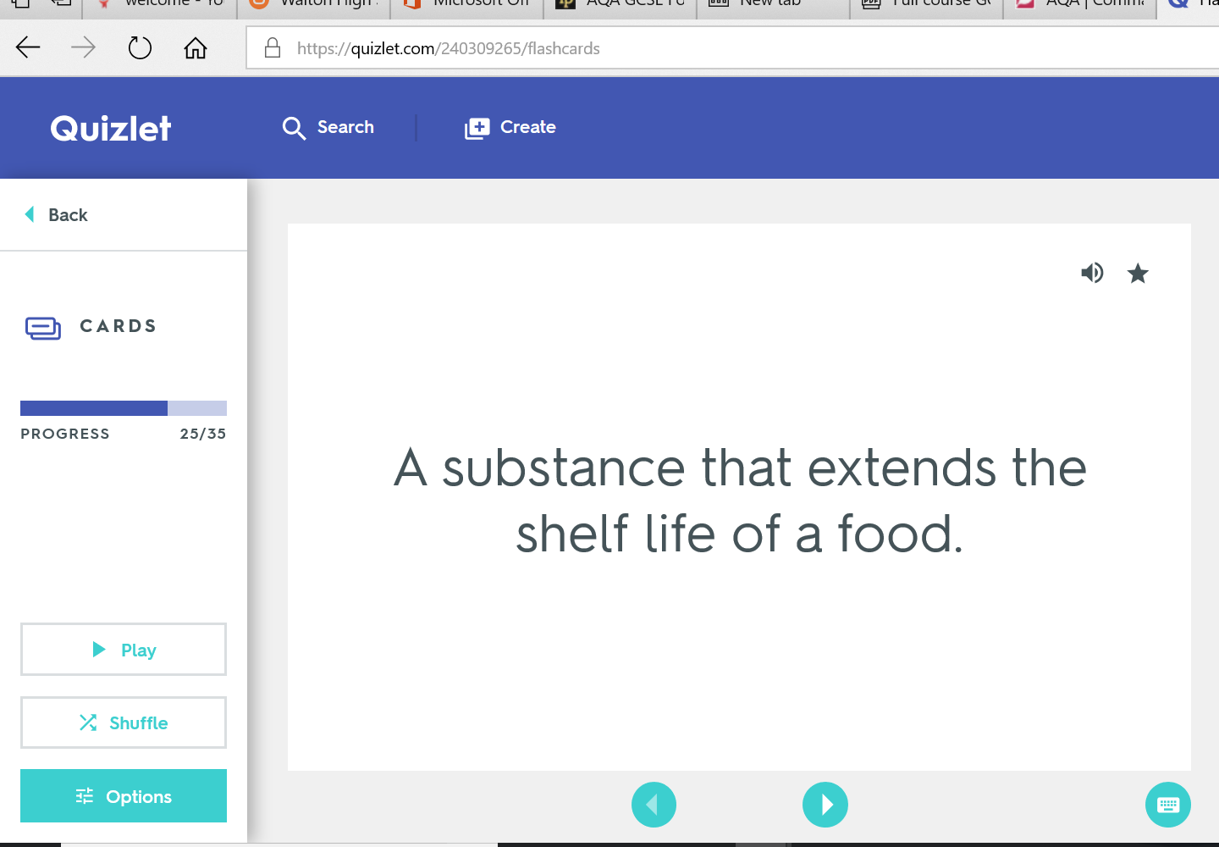
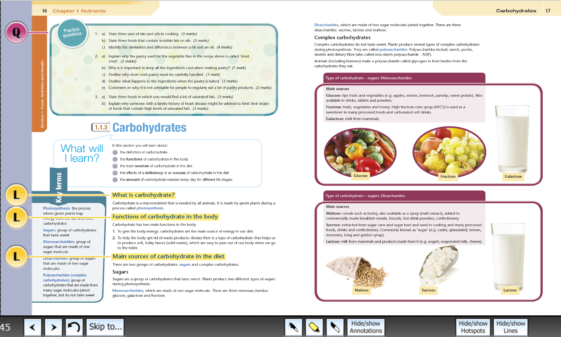
Useful Websites
HELPFUL RESOURCES
WEBSITES
https://www.ifst.org/lovefoodlovescience
https://www.nutrition.org.uk/
https://www.grainchain.com/all-resources
https://www.ifst.org/
https://quizlet.com/240309265/gcse-food-preparation-nutrition-keywords-flash-cards/
ONLINE TEXTBOOK
www.illuminate.digital/aqafood
Student Username: SWALTON3
Student Password: STUDENT3

Slide 5
Food, Nutrition & Health
You must be able to demonstrate knowledge and understanding of the functions, structures and main sources of protein, carbohydrates and fat. Know the biological value of protein, understand an individuals need for carbohydrate, understand the consequences of excess and deficiencies of protein, carbohydrate and fat.
Demonstrate the knowledge and understanding of the sources and functions of vitamins and minerals. Understand the consequences and deficiencies of vitamins and minerals. Understand the retention of water soluble vitamins during cooking.
Demonstrate the knowledge of the Eatwell Guide and health eating guidelines. Understand diet requirements throughout life and diet related illnesses
Key Points
Protein is required by the body for growth, maintenance and repair.
Proteins are built up of units of amino acids.
Fats can be classified as either saturated and unsaturated.
Saturated fats are considered to be more harmful to health because they raise levels of cholesterol.
Carbohydrate provides the body with energy.
Most of our energy should come from complex starchy foods.
Vitamins are micronutrients, required in small amounts to do essential jobs in the body.
Water soluble vitamins are easily destroyed during preparation and cooking.
Water makes up two thirds of the body so it is vital to drink regularly to stay hydrated.
Nutritional needs change throughout life, but everyone needs to consider the current healthy eating guidelines when planning meals.
Energy balance is the balance of energy consumed through eating and drinking compared to energy burned through physical activity.
Quick Test
What are the functions of fat in the diet?
Give an example of protein complementation.
What does NSP stand for?
What are the fat soluble vitamins
What is peak bone mass?
Why is a good supply of folic acid needed in early pregnancy?
What is Osteoporosis?

Slide 6
Food Science
You must be able to know and understand the reasons why food is cooked and how heat is transferred to food. Know the reasons for selecting different cooking methods. Understand protein denaturation and coagulation. Know about the properties of protein in gluten formation. Understand enzymic browning and oxidation in fruit and vegetables. Understand the functional and chemical properties of carbohydrates, which are gelatinisation, dextrinization and caramelisation. Understand the processes of raising or aerating using physical and mechanical methods. Know and understand the working properties of chemical and biological raising agents.
Key Points
Cooking food makes it safe, allows it to keep for longer and makes it more palatable.
Cooking methods can achieve specific characteristics in food.
Heat is transferred by conduction, convection and radiation. Cooking commonly uses a combination of heat transfer methods.
Proteins are denatured during cooking. Egg proteins coagulate or set when they are heated.
Wheat flour contains the protein gluten. Gluten forms the structure of pastries, breads and cakes.
Enzymes can cause the browning of fruit and vegetables. Fruit and vegetables need careful handling during preparation to prevent enzymic browning.
Gelatinisation is the function of starches as thickening agents.
Sauces can be different thicknesses when the proportion of ingredients is altered.
Dextrinisation is the term used to describe browning of starch caused by heat.
Caramelisation is the browning of sugars caused by heat.
Fat makes pastry short and crumbly.
Fats give colour and flavour to pastry. The plasticity of fat allows it to be used for rubbing in, spreading and creaming.
Fats can help aeration in baking.
Emulsions are mixtures of liquids that do not normally mix. E.g oil and water. Egg yolks contain lecithin, a natural emulsifier. Eggs help stabilise mayonnaise.
Quick Test
Name three types of heat transfer.
Why is food cooked?
What is the term used to explain the way heat changes the texture of egg proteins?
What causes the browning of cut fruit and vegetables?
What is the main heat transfer method when boiling food?
What sort of heat transfer commonly causes dextrinization?
What term describes thickening a sauce using starch?
What term describes how fat makes a short texture product?
Which basic cake making process traps air into the cake?
How does egg white trap air?

Slide 7
Food Safety
You must be able to know the growth conditions for microorganisms and enzymes and the control of food spoilage. Know and understand that bacteria, yeasts and moulds are microorganisms. Explain that enzymes are biological catalysts usually made from proteins. Demonstrate the knowledge and understanding of the use of microorganisms in food production, including moulds in the production of blue cheese, yeast as a raising agent in bread.
Know and understand the different sources of bacterial contamination. Know and understand the main types of bacteria that cause food poisoning. Demonstrate knowledge and understanding of the main sources and methods of control of different food poisoning bacteria types. Recognise the symptoms of food poisoning. Know and understand the food safety principles when buying and storing food. Know and understand temperature control and the danger zone temperatures.
Key Points
Bacteria are found everywhere and need the right temperature, warmth, time, nutrients, pH level and oxygen to grow and multiply.
Microorganisms (bacteria) are used to make a wide range of food products.
Bacteria are used to make cheese, yogurt and bread.
The most important bacteria in food manufacturing are Lactobacillus species.
Bacterial contamination is the presence of harmful bacteria in our food, which can lead to food poisoning and illness.
As a food handler you must do everything possible to prevent this contamination.
What are the main symptoms of food poisoning?
Name three bacteria responsible for food poisoning?
Which groups of people are more at risk of food poisoning?
When handling food at any stage care must be taken to prevent contamination.
Everything possible must be done to control the conditions that allow bacteria to multiply causing food poisoning.
Quick Test
What are microorganisms?
What is the ideal temperature for bacterial growth?
What is the most important bacteria used in food manufacturing?
What are the two date marks you need to check when buying food?
What is the recommended temperature for chilled food?
What is the temperature range of the danger zone?
Explain the term cross contamination.
List four occasions during food preparation when you must wash your hands.

Slide 8
Food Choices
You must be able to understand that religions, customs and beliefs influence food choice. Know about conditions that may be caused by intolerance or allergy to food. Understand the meaning of ‘cuisine’ in terms of the food related to the traditional eating habits of certain countries. Learn about the cuisine of two other countries as well as British traditional cuisine. Understand how to taste food products using your senses accurately. Know about a range of sensory testing methods. Know which information is legally required for a food label. Explain how this information will help the consumer. Understand the ways in which nutritional labelling can be shown. Provide reasoned suggestions for food choice based on a range of factors.
Key Points
If you can’t tolerate certain foods you have to change your diet.
Some religions have their own dietary laws and rules.
Diabetes is a condition caused because the pancreas doesn’t produce any or enough insulin.
Coeliac disease is a condition where people have an reaction to gluten.
Lactose intolerance is caused when the body is unable to digest lactose (a sugar found in milk and diary products).
An allergy to nuts can cause anaphylaxis.
The reasons why people become vegetarian include religion, dietary laws, ethical reasons, health or family.
Cuisine relates to the range of dishes and foods of a country or religion.
Cuisine is also concerned with the use of distinctive ingredients and specific cooking and serving techniques.
Accurate sensory testing of foods helps manufacturers and cooks develop food products and improve recipes.
The human olfactory system (smell) and taste sensors are important when tasting food.
EU= European Union
FSA=Food Standards Agency
People need to make informed choices about the food they buy based on their income, lifestyle and preferences from the food available to them.
Many factors affect the food choices that people make.
Quick Test
What religions traditionally do not eat pork?
Which foods can people with coeliac disease not include in their diets?
Name two traditionally British dishes.
Why is it important to use codes when tasting foods?
List the stages used to carry out a controlled sensory analysis
What is triangular testing?
What information must be included on food labels by law?
What does PAL mean?
Explain the different factors that affect peoples food choice.

Slide 9
Food Provenance
You must be able to demonstrate knowledge and understanding of the environment issues associated with food and its production. Demonstrate knowledge and understanding of where ingredients are grown, reared and caught. Have a clear understanding of different farming methods and their effect on the environment. Demonstrate knowledge and understanding of the impact that food has on local and global markets. Demonstrate a knowledge of primary and secondary processing. Know and understand how processing affects the sensory and nutritional properties of ingredients.
Key Points
Food and packaging waste contributes to greenhouse gases (GHG’s)
Seasonal and sustainable foods address many environmental issues.
MSC – Marine Stewardship Council = Seafood can be traced back to a certified sustainable fishery.
Food miles are the distance food travels from its point of origin to your table. Recycling and producing less waste can help reduce carbon emissions.
Nearly a third of all food produced ends up in landfill sites where it gives off methane gas as it decomposes.
Cheaper foods are ones that are GM/intensively farmed
Best quality protein foods are ones where the welfare of the animals has been considered.
Hydroponic farming is the production of food using specially developed nutrient rich liquids rather than soil.
Free range farming allows animals to access outdoor areas as part of their life. Increased demand for fish stocks has seen stocks diminishing in the wild due to over fishing.
Barn reared animals live in an environment similar to intensive farming
Under EU law, all foods need to be traceable from field to fork.
Carbon emissions and global climate change affect food and water supplies. Sustainable food production ensures less negative impact on the environment and the farmers.
Quick Test
Explain what food miles are.
Give two ways that fish stocks can be made more sustainable than intensive farming.
What are the benefits are free range farming>
Why is it important that the origins of food can be traced?
What does the flag on the Red Tractor logo mean?
How does Fairtrade support farmers in developing countries?
Which two gases contribute to global warming?
What is the outer skin on the wheat grain called?
What is homogenised milk?
What type of flour is used to make pasta?
Which vitamins may be lost during irradiation?
How does vacuum packaging differ to MAP?

Slide 10
Food Preparation Skills
You must be able to understand two different methods of using knives to prepare food safely. Explain the techniques used when preparing different foods that require knife skills. Know how to classify different types of fish. Explain how to choose, handle and prepare different types of fish.
Understand the structure of meat and how this affects the cooking methods used. Understand that a recipe consists of specific quantities of ingredients that are prepared, using a variety of skills, to produce the required outcome. Know that making and shaping dough is a precursor to making a variety of flour-based mixtures. Understand the function of ingredients in dough.
Key Points
Specific types of knives are designed for different cutting and shaping tasks.
Knives are dangerous if not handles correctly and care should be taken at all times.
A flat and stable cutting surface is essential to avoid injury when cutting food.
There are specific terms used for vegetable cuts relating to the size and shape of the outcome.
White fish carry oil in the liver; oil fish carry oil throughout the flesh.
Its important to wash your hands after handling fish to prevent cross contamination.
The length and type of cooking method depends on the type of muscle fibre.
Enzymic activity occurs when cut fruit and vegetables react with oxygen to turn them brown.
Various foods can be coated with ingredients to create a new layer to protect, add texture and flavour – this is called coating or enrobing.
Dough is made by mixing flour with liquid, and sometimes includes leavening (raising) agents as well as other ingredients and flavourings.
Quick Test
Name the two methods of holding food when cutting it.
Which type of fish contains the most Omega 3 fatty acids?
Describe two quality checks for fresh fish.
Tough meat has what length of fibres?
Where would you store meat when not preparing it?
What glaze would you use on enriched dough?
What type of flour is used to make bread dough?
What gas does yeast produce?

