Slide 1
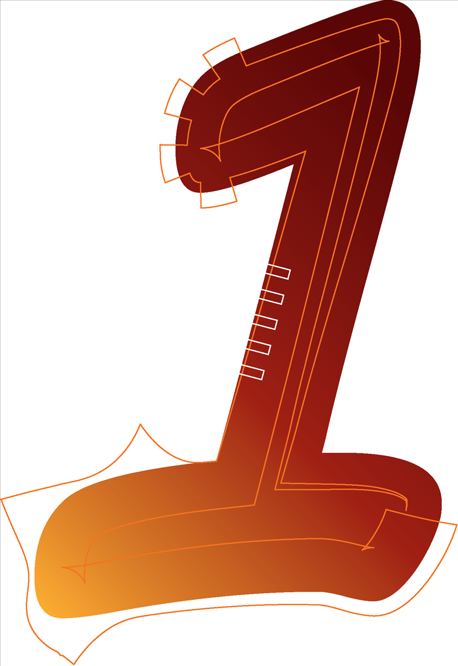
The Title
How many different ways can the title be interpreted?
What does it mean and what clues can it give you about the content or tone of the poem?
Read the poem quickly to see if any words or phrases support your understanding of the title.
How does the beginning and ending of the poem connect to the title?

Slide 2
The Subject / Theme
What is the subject or topic of the poem?
What is the writer discussing?
Is the topic something the poet seems to have a lot of experience in? How do you know this?

Slide 3
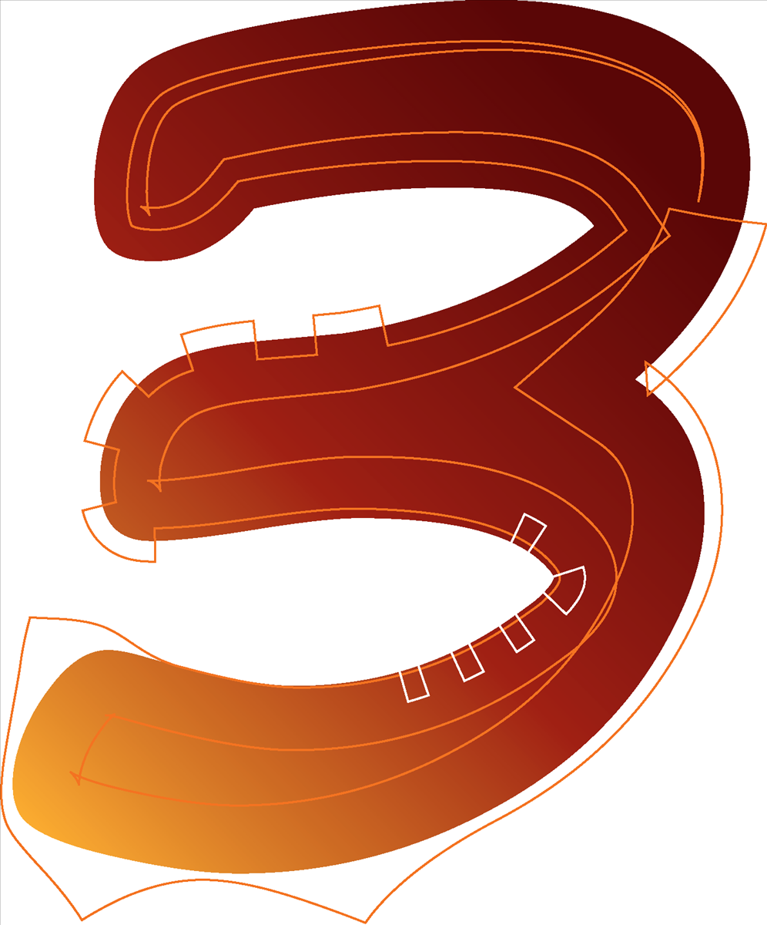
The Tone / Voice
Who is the speaker in the poem? Is there a clear persona / voice?
How does the speaker feel in the poem? Are they talking to someone or to themselves?
How would you describe the tone – look at the language choices to help you. E.g. Are they friendly, aggressive, sentimental, melancholy, romantic?
Is the poem light-hearted or serious? Look carefully at the language and the rhyme scheme to help you decide.
What tense is the poem written in? Why is this significant?
Has the poet included any “speech marks” or someone else’s voice in the poem along with theirs? Why is this significant?

Slide 4
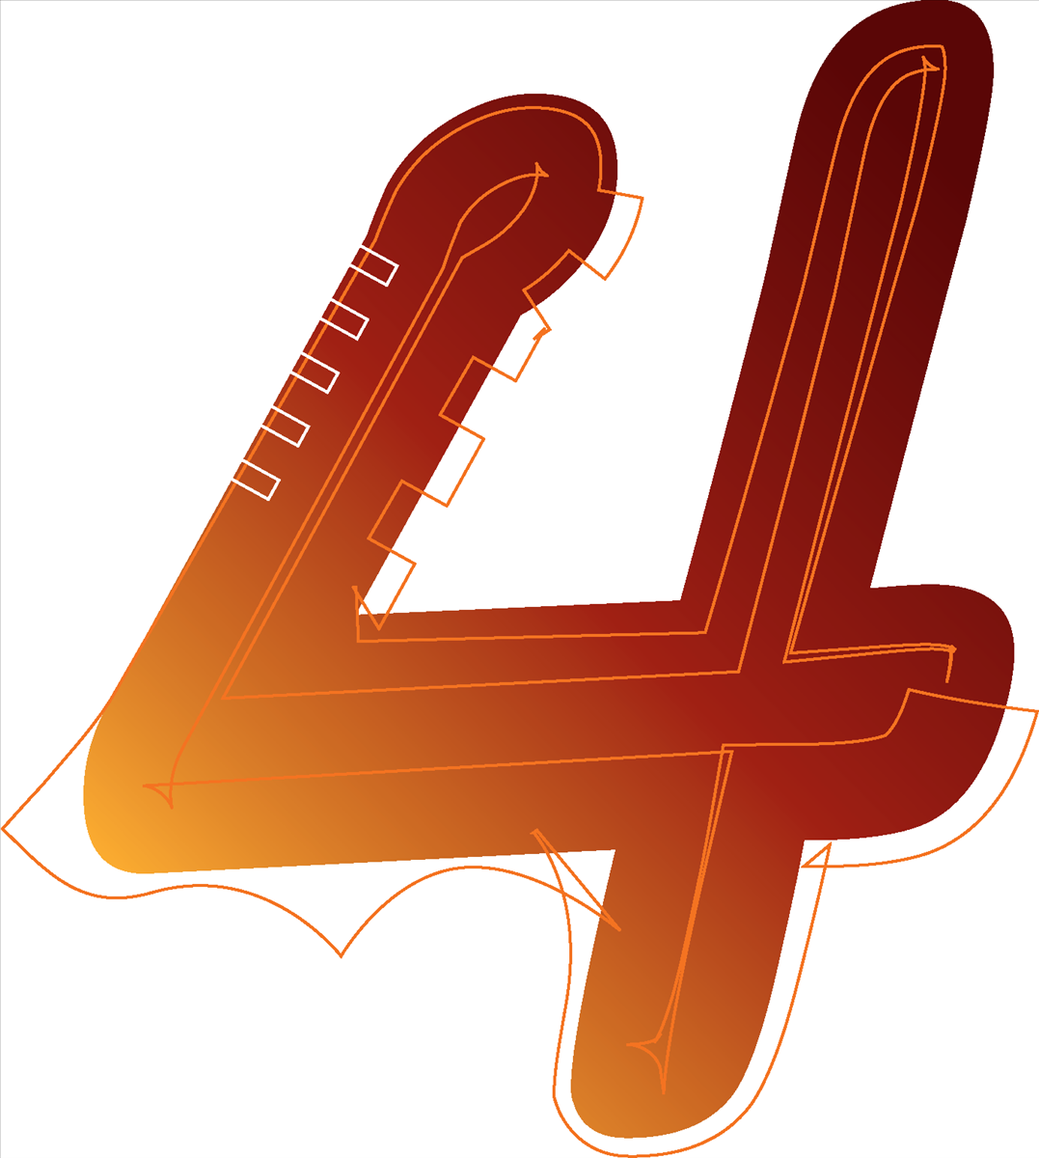
Vocabulary
What words or phrases stand out to you? Why?
Are any words or phrases repeated? Why do you think this is significant?
Do any words or phrases link / or look similar? What effect does this have?
Does the poet use formal or informal language? Has standard English been used throughout or has the poet included colloquialisms? Why do you think the poet has done this? Does it suit the topic / tone?

Slide 5
Imagery / Poetry Techniques
What visual images have been created in the poem and how has the poet achieved this?
Have any similes or metaphors been used? What objects / items has the poet used for their comparisons? Why are these significant?
Have any other literary techniques been used and what are their significance?
E.g. Alliteration, assonance, sibilance, onomatopoeia, personification, juxtaposition, oxymoron, rhyme?

Slide 6
Shape and Structure
Does the poem have a recognisable form? E.g. A sonnet, ballad, a narrative.
Does it rhyme?
Why is this a suitable form for this poem?
Are the line lengths all equal or do any stand out? Why has the poet made one shorter / longer than the rest?
What does the poem look like on the page? Does it have an unusual shape? Why do you think the poet has done this?
Is the poem written into stanzas? How has it been divided and what is significant about each stanza and how they connect to each other?
Are the lines end stopped or do they run into each other (enjambment)? Why has the poet done this?

Slide 7
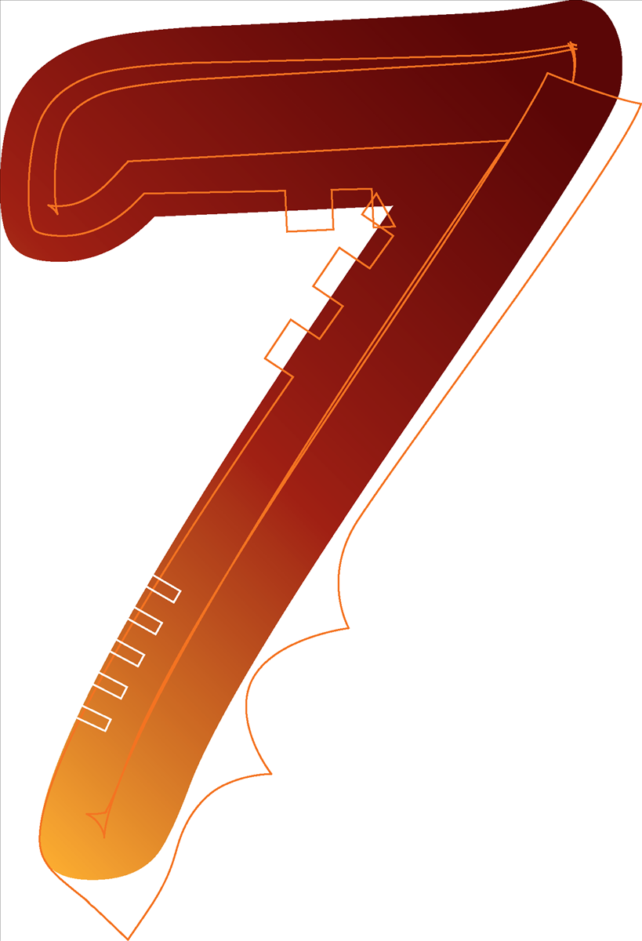
Personal Response
Is there a message behind the poem?
Is the poem an emotional response to an event?
Is it written for someone?
Is the poet trying to trigger an emotional response from you? What is it and how have they achieved this?

Slide 8
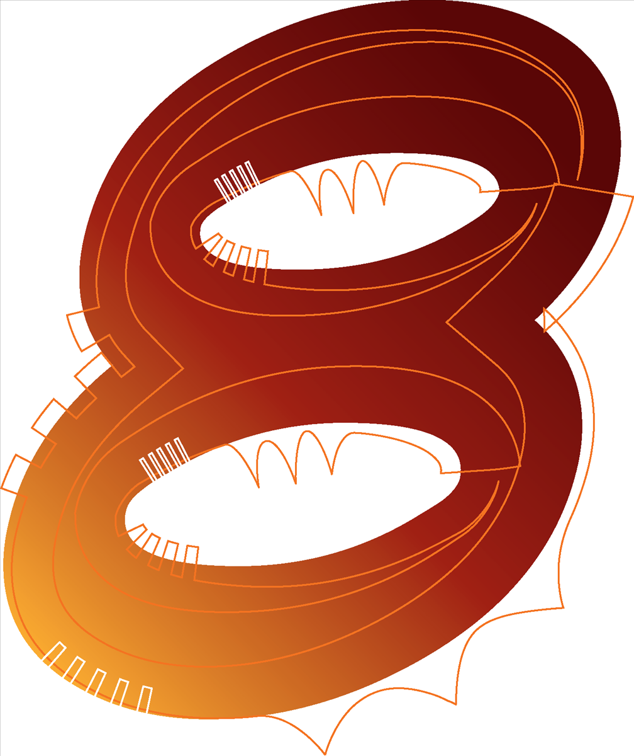
Interpretations
Now you must put all of your ideas together and consider what you think is being suggested through the poem in a written response:
The poem suggests...
The form may mean...
The voice in the poem supports this interpretation because...
The vocabulary could be interpreted as being...
The use of imagery in the poem...
Alternatively, it could be argued that the poet is presenting...
Remember to not make sweeping statements about the poem. You are offering an interpretation – not THE interpretation, so this should be reflected in your writing.

