Slide 1
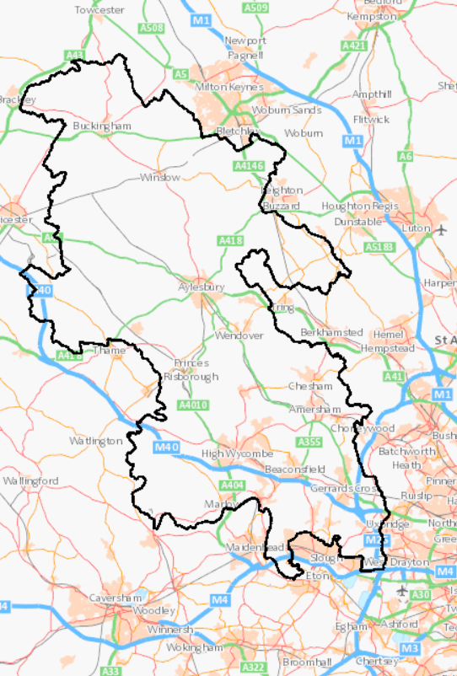

Understanding the local job market
Part 1: Exploring career options in Buckinghamshire
Part 2: Understanding the effect of COVID on the economy
Notes:
The presentation will help to deliver Gatsby Benchmark 2 by helping students and parents to understand and use labour market information. The aim is for a school’s Enterprise Adviser or another local employer to deliver it (either face to face or virtually) and to make it into an interactive encounter (so expanding it into Gatsby Benchmark 5).

Slide 2
EXERCISE 1 - Which five sectors of the Buckinghamshire economy employ the most people?
Wholesale & retail
Hospitality
Education
Finance & insurance
Manufacturing
Construction
Admin & support services
IT / digital
Public administration
Transport & storage
Agriculture
Property
Energy & water
Health & social work
Professional, scientific & technical
Creative
Notes:
Ask students to discuss in pairs for 2 minutes. Leave the next slide on view to help them, then ask for answers.

Slide 3
To help you: what each sector covers
Sector | Examples
Wholesale and retail | Sale of goods to retailers and to customers
Hospitality | Pubs, restaurants, hotels
Education | Schools, colleges, universities
Health and social work | Hospitals, medical centres, residential care homes, social work
Manufacturing | Manufacturing of goods (from cars to medicines)
Construction | Construction and fitting out of buildings, roads, railways etc
Transport and storage | Passenger transport, goods (freight) transport, storage of goods
Creative | TV and film, theatres, music, design
IT / digital | Computer programming, telecommunications (e.g. mobile phone), website design
Finance and insurance | Banks, insurance, pensions
Property | Buying and selling of houses, offices, factories and shops
Professional, scientific & technical | Research, engineering, accountancy, architecture
Admin & support services | Security, cleaning of buildings, call centres
Public administration | National government, local government, prisons, fire service, justice system

Slide 4
ANSWERS - the five sectors of the Buckinghamshire economy that employ the most people are…
Wholesale & retail
Hospitality
Education
Finance & insurance
Manufacturing
Construction
Admin & support services
IT / digital
Public administration
Transport & storage
Agriculture
Property
Energy & water
Health & social work
Professional, scientific & technical
Creative
Notes:
Did students get them right? Were they surprised at the answers?

Slide 5
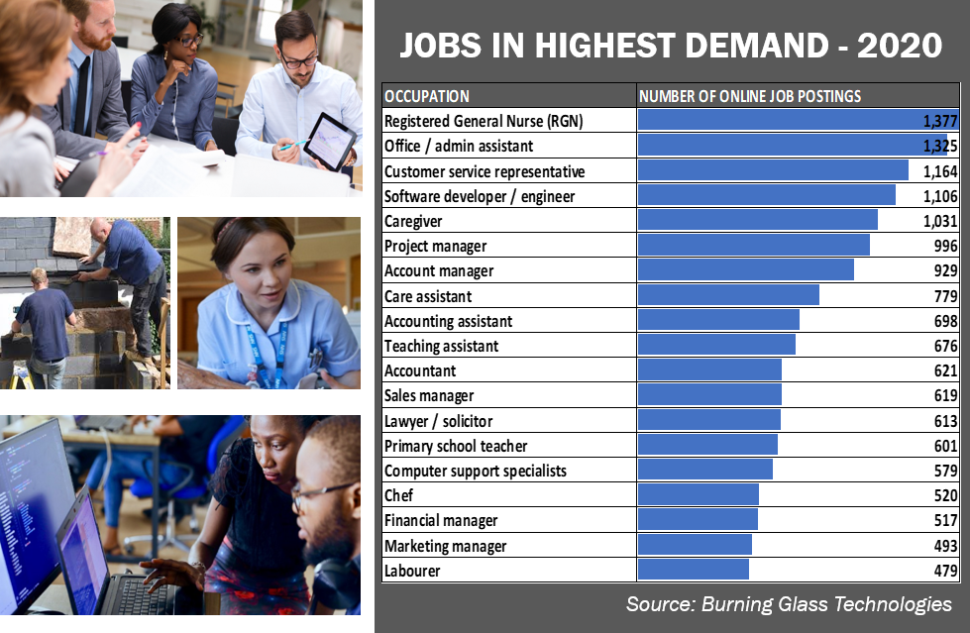
EXERCISE 2 - Which jobs do you think are in highest demand in Bucks?
?
Notes:
Again, ask students to discuss in pairs for 2 minutes which are the ‘top jobs’ (the ones employers need the most of) in our county.

Slide 6
ANSWERS - Jobs in the highest demand in Bucks are…
Notes:
Ask for students’ feedback. Did they guess right? Were they surprised?

Slide 7
EXERCISE 3 – What do these terms used to describe the job market mean?
Term | What it means
‘Sector’ or ‘industry’ | An area of the economy in which businesses or organisations operate in a similar way
Public sector | Organisations that provide public services (healthcare, education, emergency services) that do not seek to generate a profit
Private sector | The part of the economy run by individuals and companies to generate a profit
Voluntary, third or ‘not for profit’ sector | Organisations whose primary purpose is to create social impact and enrich society rather than generate a profit. For example charities, environmental groups, community groups.
Employee | Someone who paid a salary by a company or organisation to do a specific job
Self-employed worker | Someone works for themselves, either undertaking pieces of work for different companies / organisations, or as the owner of a business
Job postings | Job vacancies advertised online (either on job websites or on employers own websites)
Skills shortages | When employers struggle to recruit people with the required skills, qualifications or experience
Transferable skills | Skills that are required in many different types of jobs
?
Notes:
Don’t spend too long getting these exactly right – it’s just to give students a flavour of the terminology and make this a two-way discussion. It depends which Year group you are presenting to. Take each term on the left in turn and ask students what they think it means or to give examples. The next slide provides the answers.

Slide 8
ANSWERS – These terms mean…
Term | What it means
‘Sector’ or ‘industry’ | An area of the economy in which businesses or organisations operate in a similar way
Public sector | Organisations that provide public services (healthcare, education, emergency services) that do not seek to generate a profit
Private sector | The part of the economy run by individuals and companies to generate a profit
Voluntary, third or ‘not for profit’ sector | Organisations whose primary purpose is to create social impact and enrich society rather than generate a profit. For example charities, environmental groups, community groups.
Employee | Someone who paid a salary by a company or organisation to do a specific job
Self-employed worker | Someone works for themselves, either undertaking pieces of work for different companies / organisations, or as the owner of a business
Job postings | Job vacancies advertised online (either on job websites or on employers own websites)
Skills shortages | When employers struggle to recruit people with the required skills, qualifications or experience
Transferable skills | Skills that are required in many different types of jobs

Slide 9
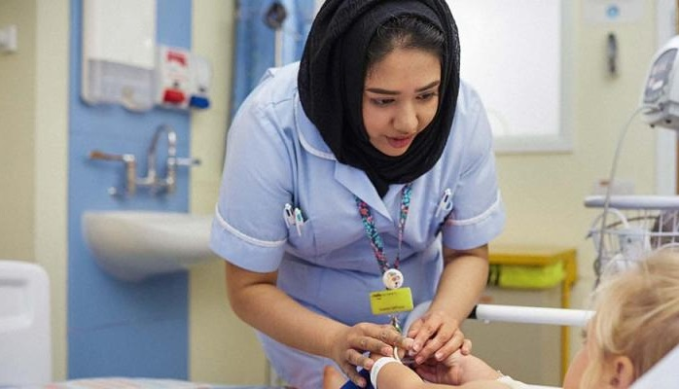
Part 1
Exploring career options in Buckinghamshire: what’s on your doorstep?

Slide 10
Key facts about the Buckinghamshire economy
36% jobs in Buckinghamshire are with small employers (fewer than 20 employees)
1 in 6 residents are self-employed
430 foreign-owned firms in Buckinghamshire
77% of jobs in Buckinghamshire are in the private sector

Slide 11


























Some large local employers…

Slide 12











And some smaller ones (with big ambitions!)

Slide 13
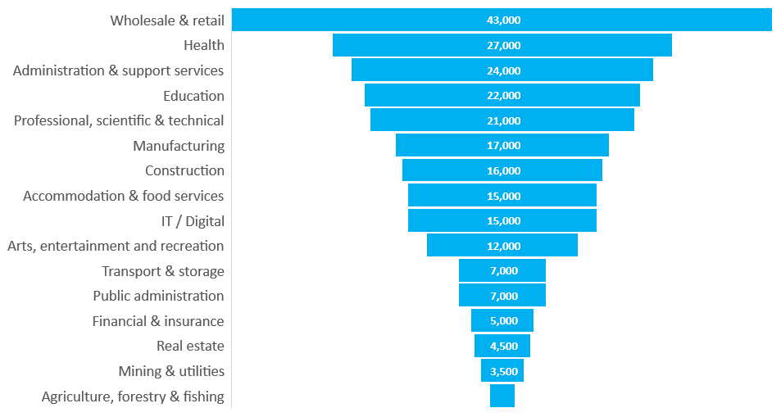
The biggest employment sectors in Bucks
Source: Business Register and Employment Survey (BRES) 2020

Slide 14




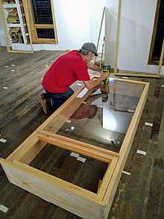




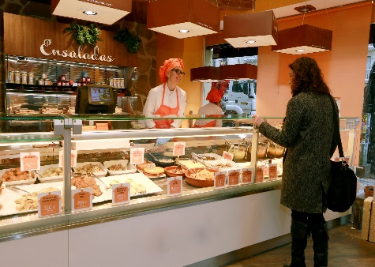


The largest self-employment occupations in Buckinghamshire
Taxi drivers &
chauffeurs
Construction
labourers
Cleaners
Hairdressers &
Barbers
Carpenters &
Joiners
Gardeners &
landscapers
Photographers, audio-visual & broadcasting equipment operators
Animal care
Painters &
decorators
Shopkeepers
Actors
Authors, writers & translators, entertainers & presenters

Slide 15

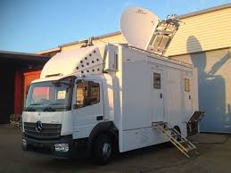
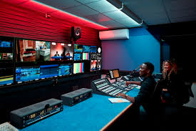
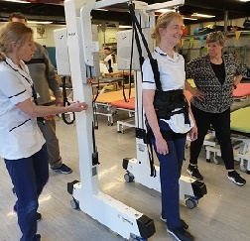
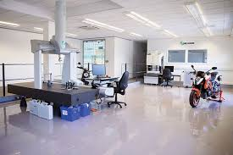



Areas of the economy our county specialises in…
From space propulsion, outside broadcasting, high-end TV and film and spinal injuries…
… to precision engineering, manufacture of measuring instruments, digital technology and pharmaceutical and computing products.

Slide 16

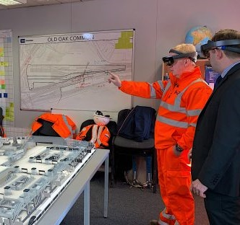

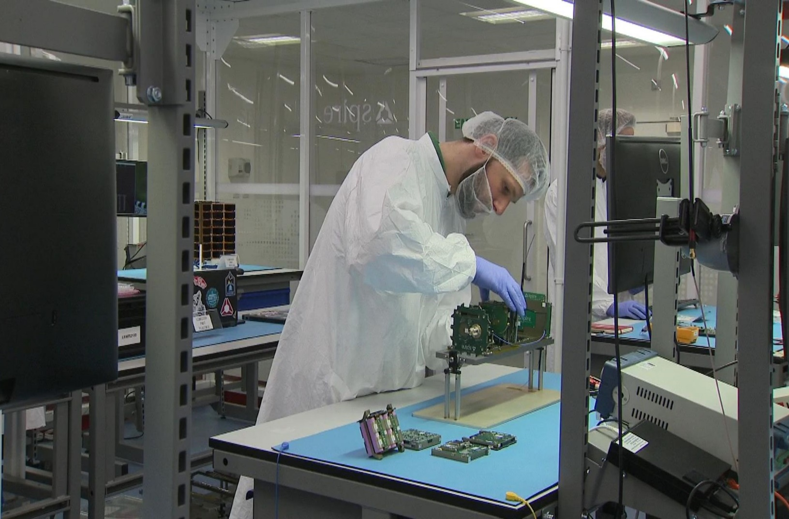
Growing industry areas in Buckinghamshire: future job opportunities?

Slide 17

WESTCOTT SPACE CLUSTER
Space is one of the UK’s fastest growing sectors.
Westcott Space Cluster is located near Aylesbury. It is home to a small but growing number of space related-companies which are developing new technologies in rocket propulsion, 5G communications and autonomous (‘smart’) systems.
Big developments are planned on the Westcott site over next 10 years. These developments are likely to create 2,300 highly skilled jobs in manufacturing and over 1,000 on-site technical apprenticeships.
There are currently skills shortages for technicians and propulsion test specialists within the space sector.
Studying STEM subjects at school is the best starting point for a career in the space sector.

Slide 18

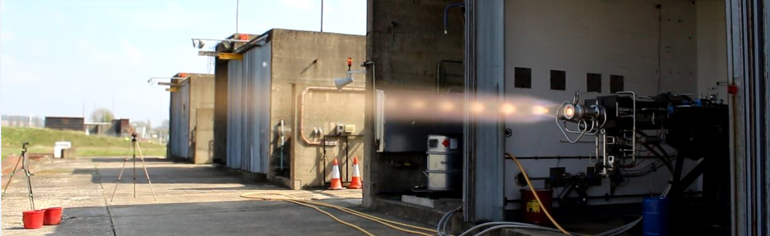
Take a look around… Nammo Westcott
Visit www.nammo.com/location/westcott/
Nammo Westcott supplies chemical propulsion to spacecraft manufacturers.
Rocket engines and thrusters are bought by commercial, defence and science markets.
In 2016 it was a Nammo Westcott engine that provided the insertion burn to allow NASA’s JUNO spacecraft to successfully enter into orbit around Jupiter.
Nammo Westcott employees work on development, production and testing.

Slide 19



FILM AND TV
In recent years, the creative sector has been growing five times faster than the national economy.
There are twice as many creative industry jobs within the Buckinghamshire economy than the national average.
Pinewood Studios, the home of the British film industry and the James Bond and Star Wars franchises, is located within Buckinghamshire.
The National Film and Television School in Beaconsfield is one of the top film schools in the world.
Other local companies include CTV Outside Broadcasts and Boundless West: think Strictly Blackpool and royal weddings; Escape to the County and Grand Designs.
There is a wide range of jobs within Bucks’ film and TV sector, including:
  Studio manager
  Marketing officer
  3D modelling artist
  Set designer
  Photographer
  Production manager
  Script writer
  Digital effects
  Camera operator

Slide 20


Take a look around… Pinewood Studios
Visit www.pinewoodgroup.com/
For over 80 years, Pinewood Studios have made dreams a reality, enabling storytellers to bring their creations to life on the big and small screen.
Home to classics including James Bond, Star Wars and the Marvel Cinematic Universe.
Pinewood Studios based in south Bucks is home to the legendary 007 Stage, 23 stages, 3 dedicated state of the art TV studios, the unique permanently-filled Underwater Stage, acres of backlot production space plus post-production and lighting services.
It has ambitions for further growth over the next few years, and hopes to create thousands of new jobs.

Slide 21
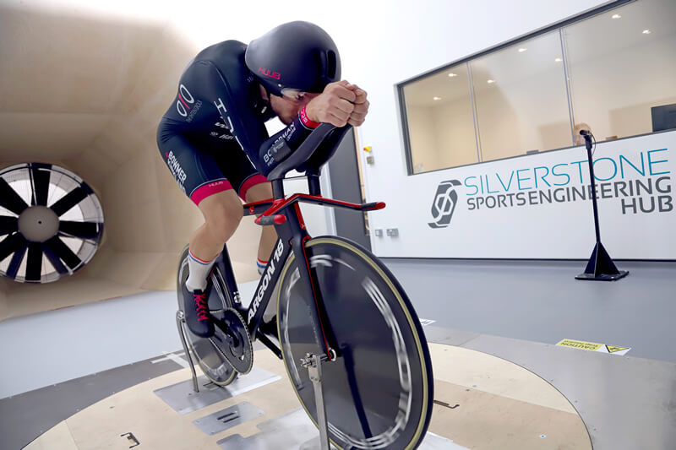
HIGH PERFORMANCE ENGINEERING
From electric cars, 3D printing and sports engineering companies based at Silverstone Technology Park near Buckingham (opposite the Silverstone Formula 1 racing circuit) to world-famous aircraft ejection seat manufacturer Martin-Baker in the south of the county, Buckinghamshire is home to ground-breaking high-tech engineering companies.
Jobs within the sector include:
product developer
human factors engineer
programme manager
software engineer
geotechnical engineer
New property developments at Silverstone Park are attracting new high-tech businesses and are creating new jobs.

Slide 22


Take a look around… Martin-Baker
Visit https://martin-baker.com
Martin-Baker is the world leader in the design and manufacture of ejection and crashworthy seats. A family-run business, it has saved over 7,600 lives.
Martin-Baker says: “We believe in helping
individuals grow... We are looking for talented and dedicated people that are interested in making a
real difference.”
Jobs range from admin support to IT network engineer, calibration inspector to equipment maintenance technician.
Find out about its apprenticeship programme at https://martin-baker.com/careers/apprenticeships/

Slide 23


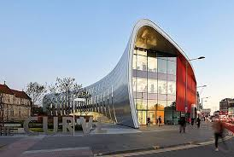

BIG NAME EMPLOYERS NEARBY
Area | Sector | Big name employers
Milton Keynes | Logistics, transport, high performance engineering, digital technology | Network Rail, Red Bull, Santander, Volkswagen Financial Services
Slough | Corporate headquarters | O2, Mars, UCB, RB
Reading / M4 corridor | Digital technology (cyber security, telecoms, cloud computing) | Microsoft, Cisco, HP, Vodafone, O2
Hertfordshire | Advanced engineering, life sciences, IT, creative | Airbus, GSK, Elstree Studios, Warner Bros
Oxford | Education, life sciences, vehicle manufacturing | University of Oxford, Oxford Brookes University, BMW

Slide 24



Who and what are employers looking for when recruiting new talent?

Slide 25
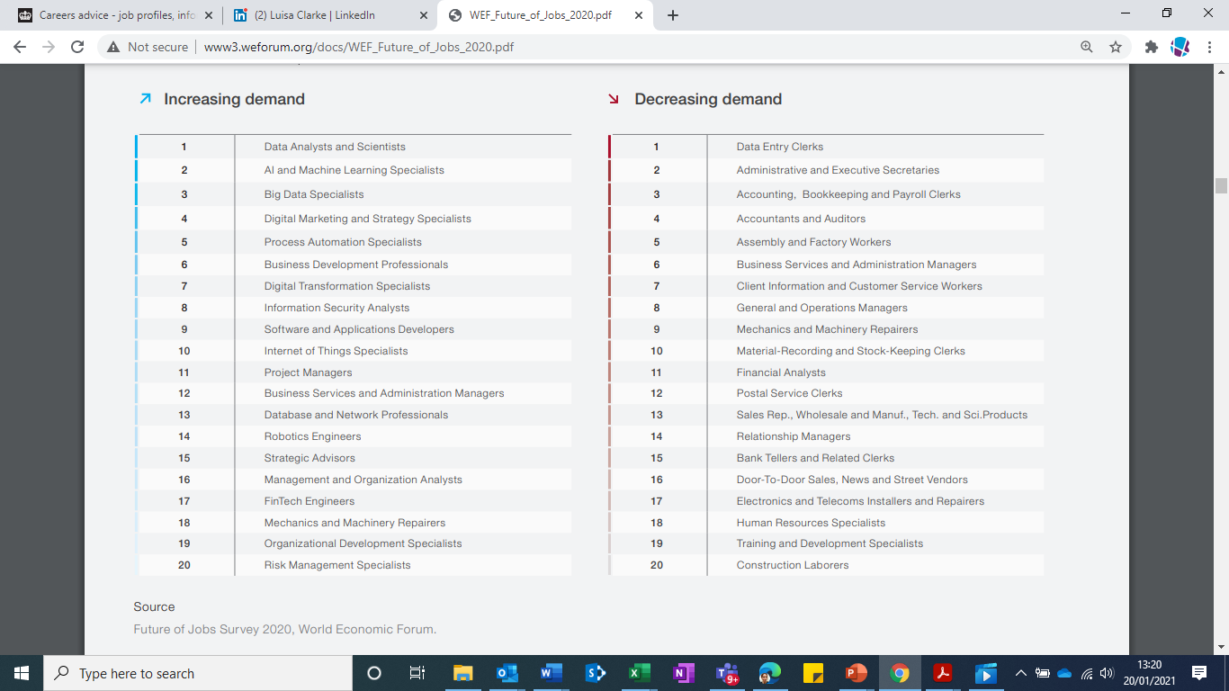
Which are the top 20 jobs going UP in demand globally?
(Source: World Economic Forum 2020)

Slide 26
Which are the top 20 jobs going DOWN in demand globally?
(Source: World Economic Forum 2020)

Slide 27
Examples of jobs with a skills shortage
HGV drivers
Paramedics
Chefs
Bio-informatician
Occupational therapists
Medical radiographers
IT business analysts, architects and systems designers
Programmers and software development professionals
Cyber security specialist
Engineers
Biological scientists and biochemists
Data scientists

Slide 28
What are the two key attributes employers are looking for in young people?
A positive attitude to work
Punctuality, flexibility and verbal communication skills
01
Resilience
The ability to cope with setbacks and criticism, be motivated to overcome obstacles and stay calm under pressure
02

Slide 29

‘Transferable skills’ are in high demand
These are skills that employees
take with them from one job and
apply them to the next, no matter
what they are doing. Sometimes
called ‘employability’ skills, they
include:
Basic literacy and numeracy
Problem solving
Communication (verbal, listening, understanding)
Self-management (time management, planning, organisation)
Teamwork
Basic IT (Microsoft Excel, PowerPoint, Word)
Creativity

Slide 30
The top 15 skills for 2025 according to the World Economic Forum (2020) are:
Analytical thinking and Innovation
Active learning and learning strategies
Complex problem solving
Critical thinking and analysis
Leadership and social influence
Technology control monitoring and use
Creativity, originality and initiative
Technology design and programming
Resilience, stress tolerance, flexibility
Reasoning and problem solving
Emotional intelligence
Service orientation
Systems analysis and evaluation
Trouble shooting and user experience
Persuasion and negotiation

Slide 31
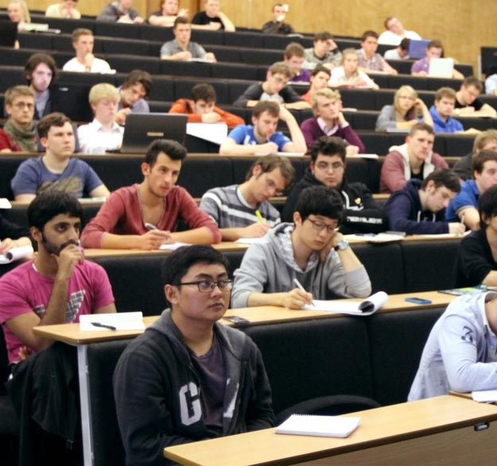



Next steps: how do you get where you want to go?

Slide 32






Consider local higher and further education colleges and universities (click on the logos for more information)…

Slide 33


… and also find out more about apprenticeships
Amazing Apprenticeships https://amazingapprenticeships.com/apprenticeships/
Information and resources on apprenticeships for students, parents, teachers and employers
Understanding Apprenticeships www.ucas.com/understanding-apprenticeships
UCAS guide to exploring apprenticeships
Find an Apprenticeship
www.gov.uk/apply-apprenticeship
The Government’s apprenticeship portal
Not Going to Uni
www.notgoingtouni.co.uk/
Ideas for alternatives to university

Slide 34
Apprenticeship opportunities in Buckinghamshire (examples)
Selection of current* Apprenticeship Vacancies | Employer | Location
Level 2 Arborist | Dickinson Tree Company Ltd | High Wycombe
Level 3 Software Development Technician | Citytalk Communications | Aylesbury
Level 3 Installation electrician / maintenance electrician | William Stranders | Aylesbury
Level 3 Dental Nurse | Amersham Hill Dental Clinic | Amersham
Level 3 Digital Marketer | IL Gusto Spirits Ltd | High Wycombe
Level 6 Chartered manager degree | Zenopa | High Wycombe
Level 3 Junior Content Producer | One Media Ip Ltd | Pinewood Studios
Over 1,000 Buckinghamshire employers offer Apprenticeships
*Summer 2020
www.findapprenticeship.service.gov.uk/

Slide 35
More first jobs which employers have been looking to fill recently
Digital marketing assistant
Junior developer
Medical analyst
Trainee teacher
Assistant property manager
Digital design intern
Teaching assistant
Laboratory technician
Graduate sales development representative
Supply chain assistant
Junior account manager
Pharmaceutical marketing assistant intern
Media assistant intern

Slide 36


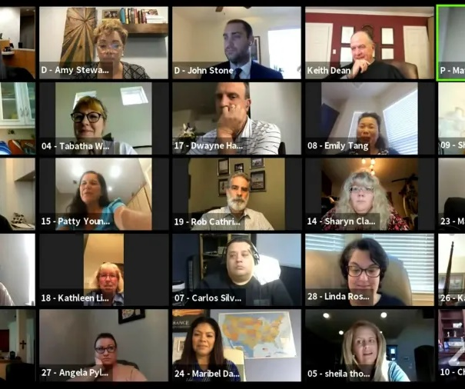
Part 2
Understanding the post-COVID economy: what does it mean for the future and how can job seekers adapt?

Slide 37
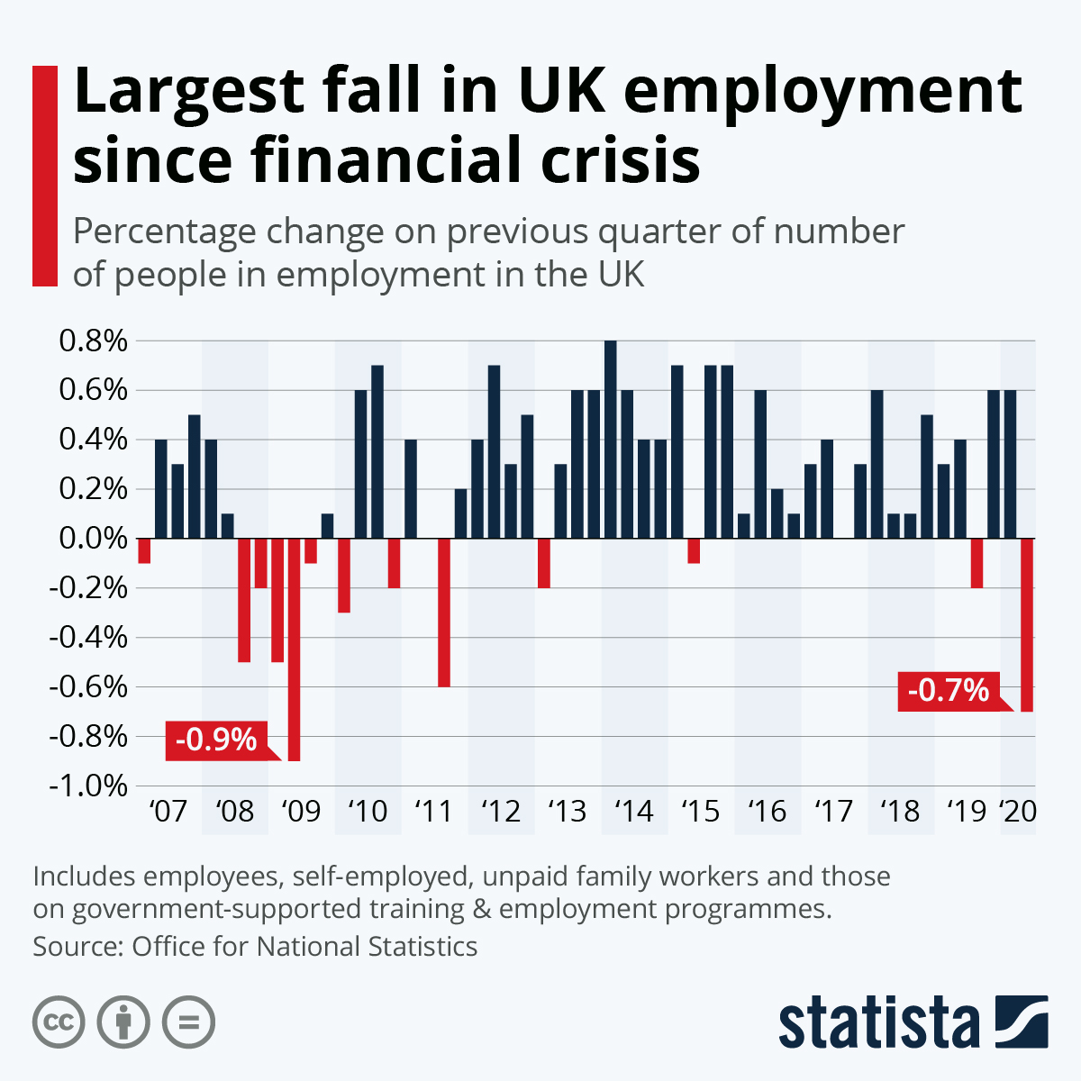
Impact of COVID-19
Challenges
More competition for jobs over the next few years – fewer job vacancies and more people looking for work
Job opportunities in some sectors likely to be scarce for some time (aviation, travel, events, marketing, the arts)
Harder to get full and part-time work in retail / hospitality
Fewer apprenticeships, placements and internship opportunities
Harder to get work experience – particularly in offices (many employees working from home)
Recruitment via video

Slide 38
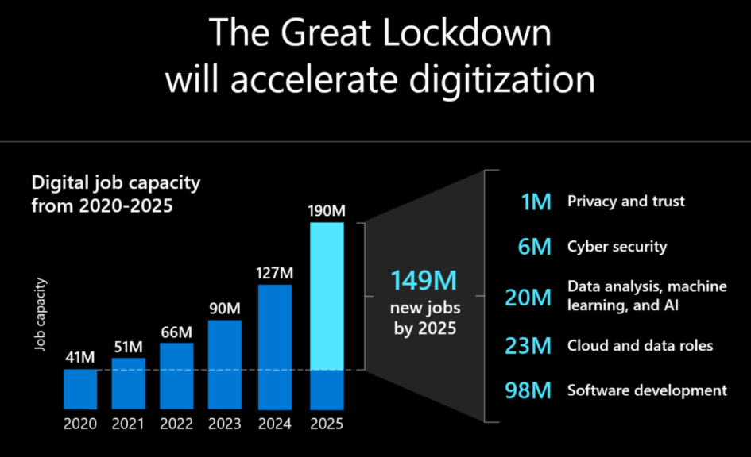
Impact of COVID-19
Reasons to be cheerful
Some sectors predicted to bounce-back
quickly, including graduate employment
sectors eg health, social care, IT, finance
Many employers are still recruiting
New government initiatives exist to help
young people into work (eg Kickstart)
Opportunities for further study
Opportunities to gain skills through
volunteering
Opportunities to start own business
More flexible working in the future
(opportunities to work from home)
Source: Microsoft Data Science using LinkedIn data 2020 – 149M new jobs refers to the global economy

Slide 39

Skills which will potentially increase in importance as a result
of COVID-19
Resilience, adaptability and agility – to quickly change strategies and perform tasks outside of usual role.
Creative thinking – to use creativity and innovation to respond to government measures and regulations.
Collaboration and teamwork (external) – to collaborate with people working in similar businesses
Digital literacy – familiarity with collaboration platforms, cloud file sharing and teleconferencing.
Data analytics and data insight – to make informed business decisions and adapt to meet changing customer expectations.
Source: Buckinghamshire LEP literature review

Slide 40








What can young people to boost their job prospects?
Work experience (including part-time work)
Placements/
internships
Apprenticeships
Build a CV
Interview practice (including virtual)
Do your research (graduate schemes, career talks,
job adverts)
Learn from experiences,
take on responsibilities
(eg volunteering, extra-curricular activities)
Get a LinkedIn profile (16+)
and start networking

Slide 41
So what should young people take away from this?
Start exploring: there is a wide range of careers opportunities within Buckinghamshire (and beyond).
Develop your skills: Employers recruiting young people want positive attitudes plus transferable skills such as literacy and numeracy, problem solving, communication, teamwork and IT.
Take action: COVID has had a dramatic effect on the economy, but you can do practical things to boost your prospects.
Aim high: Work out what you love doing, develop your future goals and motivate yourself to achieve!

