Slide 1

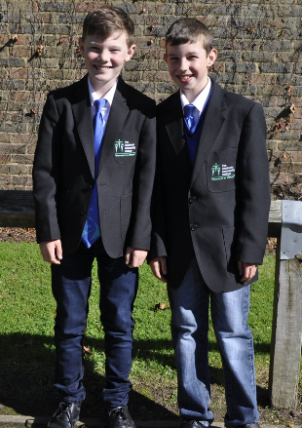
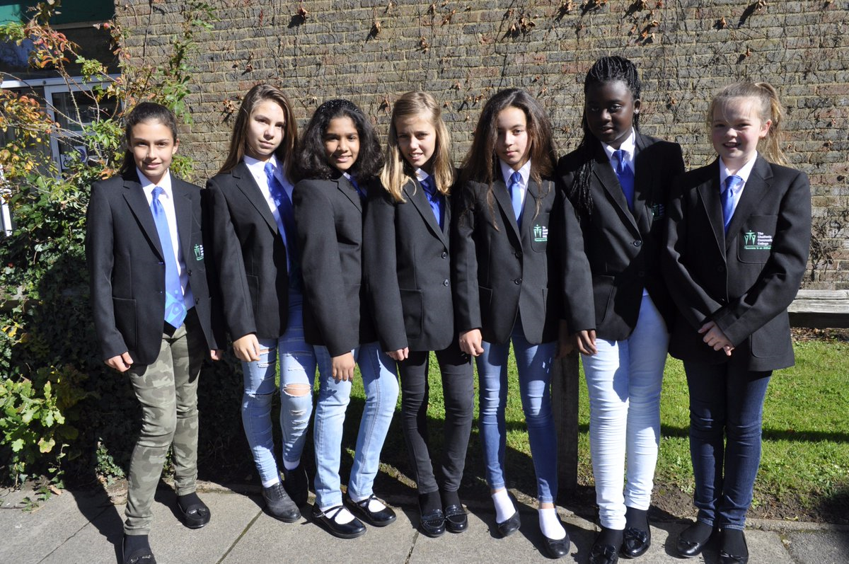

Wear your jeans to school for £1
Friday 21st September
Full schools uniform must be worn with jeans
Monies raised on Jeans for Genes Day fund the work of the charity and provide grants to organisations for projects that aim to transform the lives of children with genetic disorders

