Slide 1

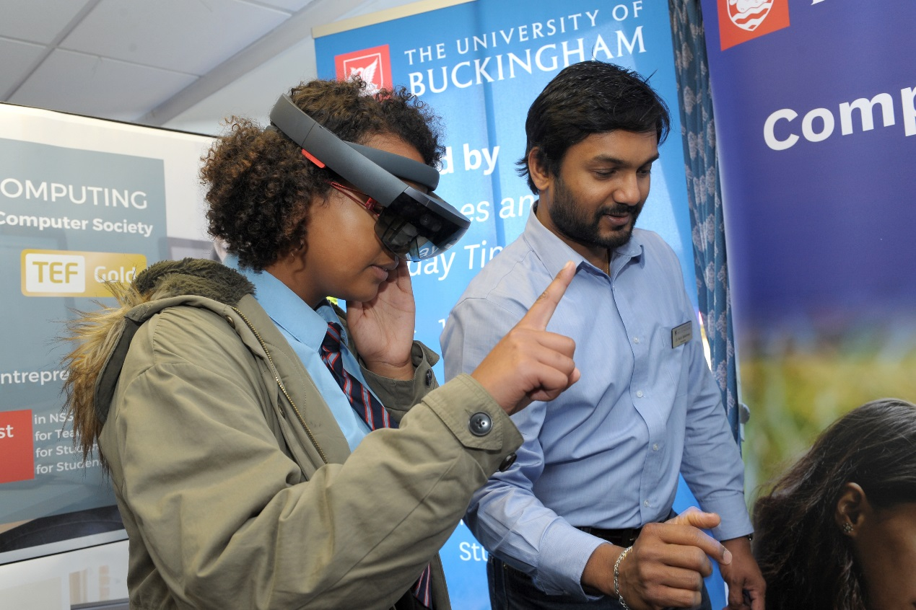


Saturday 13 October
9.30am to 3pm
The Gateway, Aylesbury
Explore careers and work out how to get there

Slide 2
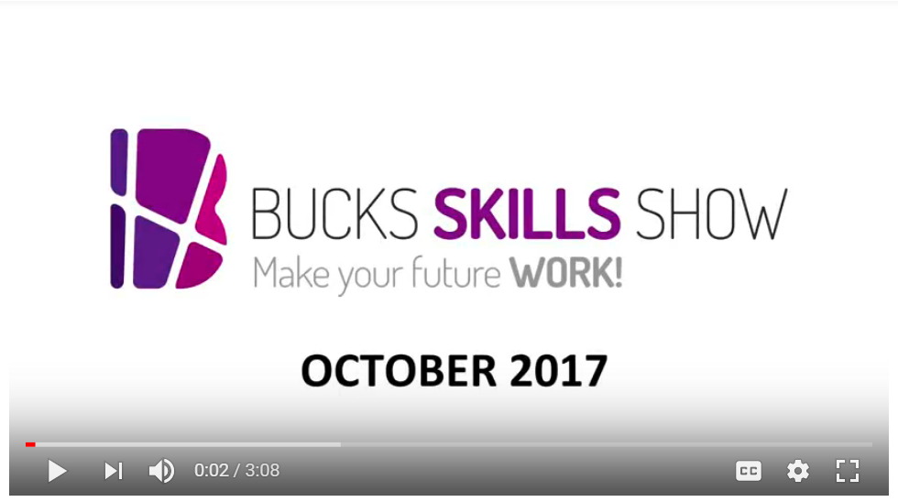
Click to watch

Slide 3
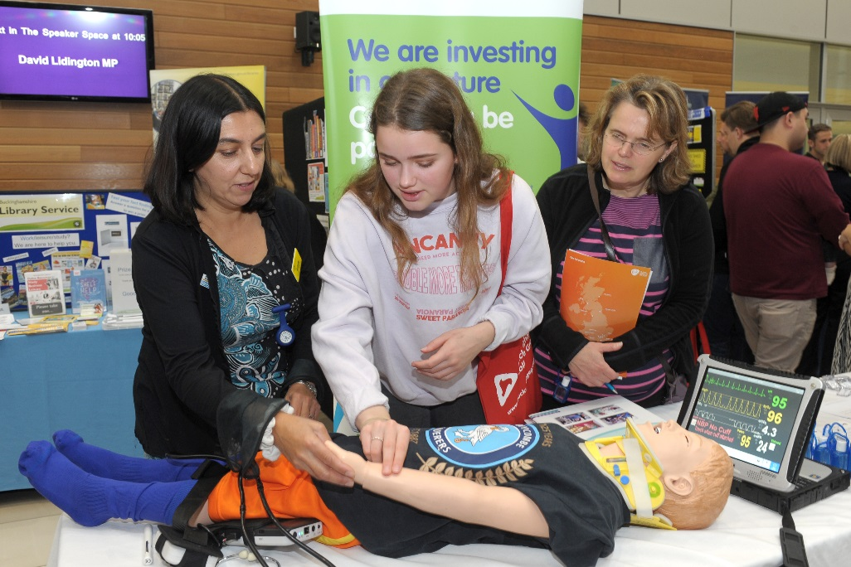
What is it?
Bucks’ largest interactive skills and
careers event.
Helps young people to explore careers and work out how to get there.

Slide 4
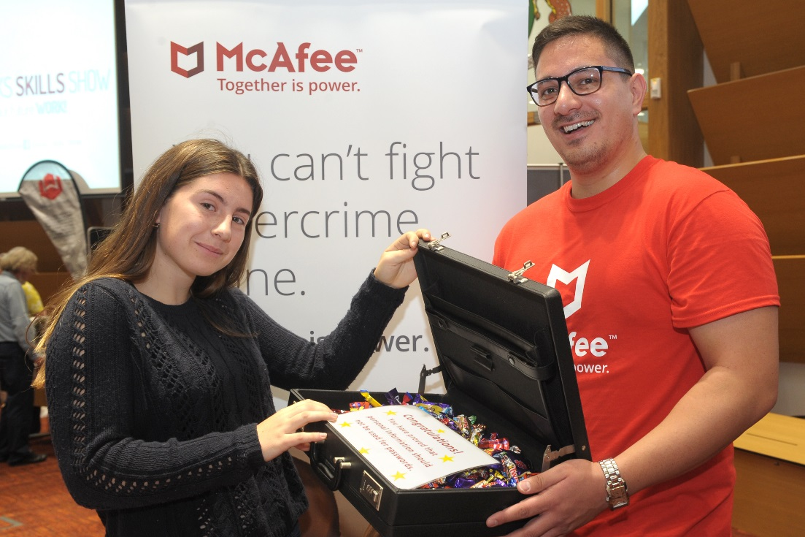
Why come?
Bring young people to meet employers face-to-face and experience industry sectors for themselves.
Meet over 70 businesses and organisations (from Bosch and Jaguar Landrover, to the International Hotels Group and McAfee, to Champneys and the NHS).

Slide 5
What industry sectors are represented?
Space industries (NEW)
Construction (NEW)
Creative industries (film, TV &
music)
Engineering, technology & manufacturing
Life sciences, health & social care
Business
Retail, hospitality & leisure
Public services
Plus FE and HE institutions in the ‘Next steps’ zone
Notes:
Creative – Pinewood Studios, Mix 96 radio, Creative Media Skills, CTV Outside Broadcast, Boundless TV
Engineering, Tech & Manufacturing – Bosch, McAfee cyber security, Institute of Engineering and Technology
Life Sciences, Health & social care – GE, NHS (both Bucks and Oxford Trusts), ambulance service
Business – Legal, insurance, banking, management
Retail, Hospitality & Leisure – Champneys spa, hairdressing, International Hotels Group (Intercontinental and Crown Plaza)
Public Services – Navy, Army, RAF, Mitie, Thames Valley Police, Ambulance service
Space industries - Reaction Engines, Nammo (sent Juno around Jupiter), National Space Agency???
Construction – Kier (HS2), CITB – construction industry training board, Flannery (plant material), Stuart Barr
Next steps

Slide 6

Notes:
From robot arms to augmented reality, gory stage make-up to a cyber-lock suitcase challenge – it’s never boring! Activities – explore an outside broadcast unit, interact with cameras, robot coding, CPR demonstrations, special effects makeup, interactive VR headsets, simbulance (simulated ambulance), climb aboard a full size Flannery digger

Slide 7


Listen to industry A-listers
High profile speakers will be sharing their career journeys and insider tips on breaking into their industries.
Some of the highlights include:
  Bosch Application Engineer Stephanie Alexander on careers in science, technology, engineering and maths.
  Alison Lomax, Director of Lifestyle Retail at Google, on careers in digital.

Slide 8


Listen to industry A-listers
  MP for Aylesbury and Minister for the Cabinet David Lidington, on the Government’s Skills Policy and Industrial Strategy.
  Reshma Rumsey, Social Affairs Producer for ITV News, on careers in TV journalism.

Slide 9


Listen to industry A-listers
  Lohan Presencer, Chairman of the Ministry of Sound, on careers in the music industry.
  Historian and Vice Chancellor of University of Buckingham, Sir Anthony Seldon OBE, on the impact of artificial intelligence on education and jobs.

Slide 10
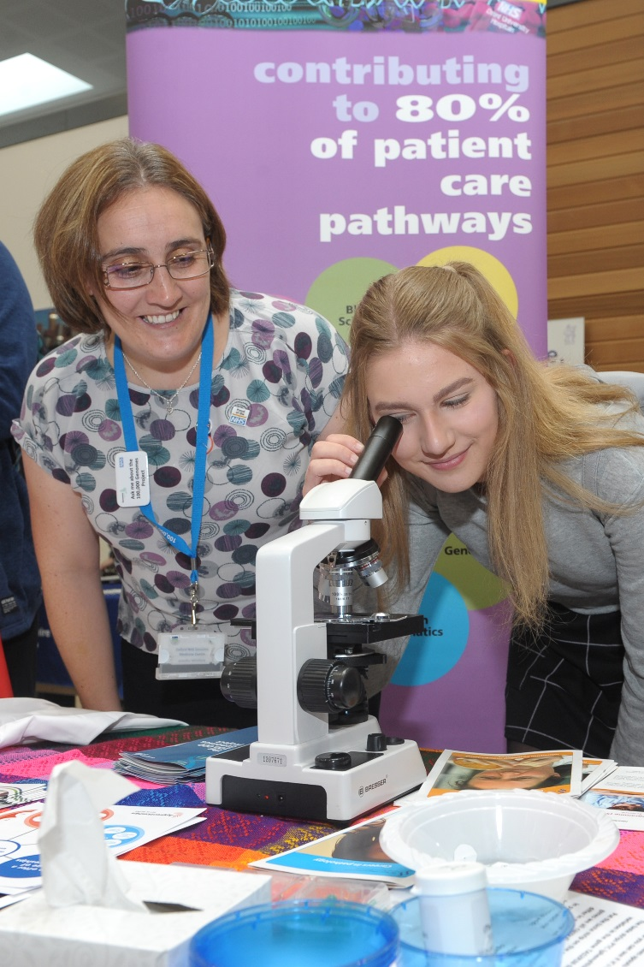
Who's it for?
All young people in secondary school, teachers, parents and carers.

Slide 11
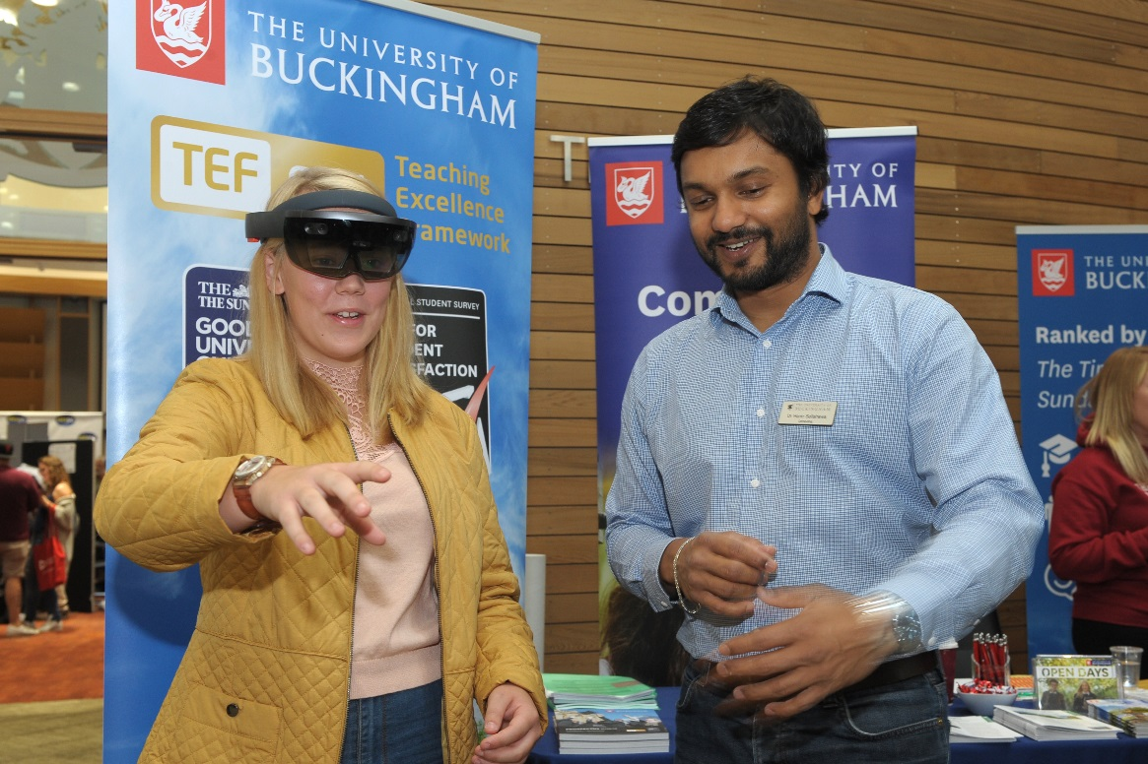
What do young people get out of it?
Network and make contacts.
Discover careers that inspire them –
and which ones don’t.
Use the opportunity to arrange work experience.

Slide 12
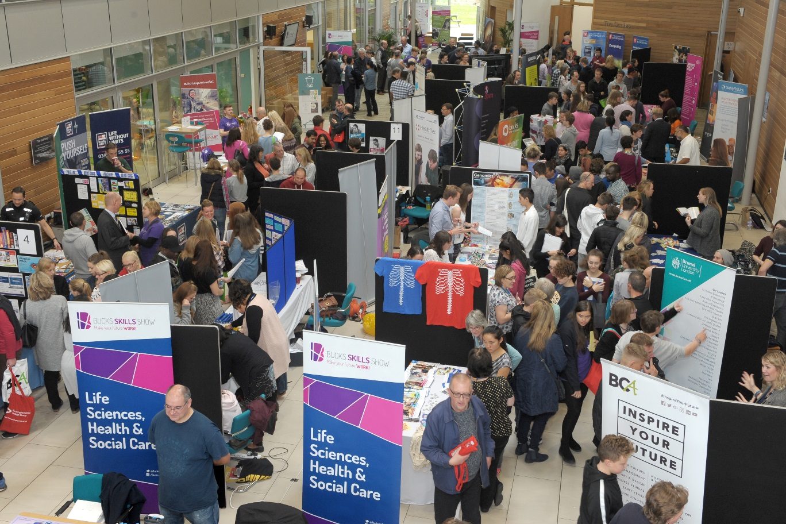
Where and when?
9.30am to 3pm
Saturday 13 October
The Gateway, Aylesbury

Slide 13
How do you book?
It’s free to attend.
Search ‘Bucks Skills Show 2018’ on Eventbrite.co.uk and book your free ticket now
Follow /BucksSkillsShow on Facebook and @BucksSkillsShow on Twitter for updates.

Slide 14

Saturday 13 October 2018 at
The Gateway, Aylesbury
Book your free tickets on

