Slide 1

YEAR 6 INDUCTION EVENING
Mr Denial (Principal)
Miss Keitch (Leader of Year 7)

Slide 2
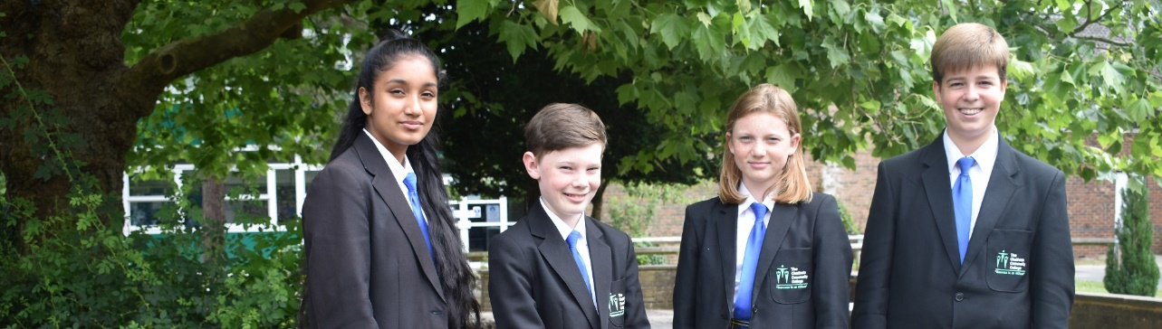
Getting it right from the start
Encourage your child to pack their school bag and lay out their uniform before going to bed each evening.
Make sure your child eats breakfast.
Allow plenty of time for your child to get to school.
Check for letters home or permission forms or planners as this will help avoid early morning panic and items being forgotten.

Slide 3

Attendance
Resilience
Attendance managers that will track and monitor every child’s attendance.
Attendance | Impact
Attendance of 96% and above | 82% achieve 5 GCSEs including English and Maths Grades 9-4
Attendance of 94% and above | Only 62% achieve 5 GCSEs including English and Maths Grades 9-4
Attendance of 90% and above (One day missed every 2 weeks) | Only 52% achieve 5 GCSEs including English and Maths Grades 9-4
Attendance of 80% and above | Only 36% achieve 5 GCSEs including English and Maths Grades 9-4

Slide 4
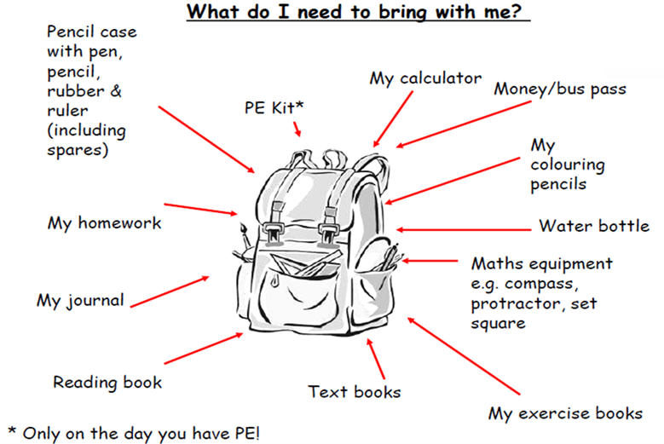
Learning Kit

Slide 5

Homework
The following is a rough guide to how long your child should be spending on homework:
Years 7 and 8 | 45 to 90 minutes a day
Year 9 | 60 to 120 minutes a day
Years 10 and 11 | 90 to 150 minutes a day
Research suggests that when students engage with regular homework it can provide an impact as large as five months better progress in learning. (Education Endowment Foundation, 2018)

Slide 6

Transport
All enquiries about transport should be directed to Buckinghamshire County Council.
If you do use College transport we have high expectations of your behaviour whilst travelling to and from College.
For more information and to view our behaviour policy on the school buses please go to - https://www.chalfonts.org/bustravel

Slide 7
Rewards and Sanctions
Merits are awarded by staff for outstanding work, effort and behaviour, attendance and reports.
Students are rewarded with - Golden tickets, postcards home, given responsibilities, tea party with the Principal, activities and reward trips.
Poor behaviour or failing to complete work can result in detentions during or after school or even internal suspension (we will work hard together to ensure this doesn’t happen).

Slide 8

A Few Reminders
Mobile phones – not to be seen or heard.
Social media
Chewing gum
Acrylic nails and nail varnish
Make up
Extreme hairstyles

Slide 9

How can you support your child at home?
Help your child keep to a routine
Offer rewards & praise
DO NOT BE TEMPTED TO DO THE WORK FOR THEM!
Encourage them to read books & the latest news
Ensure an appropriate bedtime
Monitor electronic devices and social media
Discuss homework together
Create a learning area
Talk about clubs they could join

Slide 10
Supporting Our Students
Form Tutors | First port of call
Pastoral and Welfare Support | Mrs Pieri
Year Leader | Miss Keitch
Special Educational Needs Co-ordinator (SENCO) | Mrs Gregg
Wellbeing Officer/Medical Administrator | Mrs Scott
Attendance Officer | Mrs Fawcett
School Counsellors | Claire and Marianne
Student Development, Behaviour and Welfare Manager | Miss Borer
Safeguarding Officer | Miss Lang (Vice Principal)
Peer mentors Sixth form mentors ‘Bubble’ club Year 7 quad Early break and lunch times Buddies

Slide 11
Key Dates
Dates | Information
Tuesday 27th – Friday 30th August | New intake Summer Sports Camp at the school
Tuesday 3rd September | First Day of Term for Year 7
Thursday 5th September | School Photographs
Monday 16th – Friday 27th September | Year 7 Baseline tests – no preparation required.
Thursday 19th September | Year 7 Parents Welcome Evening 6pm-8pm
Tuesday 1st & Wednesday 2nd October | Year 7 Team building trip to HOAC

Slide 12

Summer Sports Camp
Tuesday 27th August to Friday 30th August 2019.
Costs are £30 per day. Please note that any “walk-ons” will be charged at a daily rate of £35.
Sign up to be completed on the school website. Type “sports camp” into the school website and the appropriate pages will come up.
“Summer Camp allowed me to get to know the school quicker and feel less nervous” Izzy (Year 7)
“I got to make new friends and get to know people who are in my tutor group” Charlie (Year 7)

Slide 13
September 2019
Tuesday 3rd September:
Only year 7 in the main school.
Full school uniform and learning kit.
Students will spend the morning in their tutor groups and the remainder of the day in their timetabled lessons.
Wednesday 4th September:
All students in the main school.
Students will spend the morning in their tutor groups and the remainder of the day in their timetabled lessons.

Slide 14
Baseline Testing
MidYIS Testing:
It tests vocabulary, maths (speed and fluency not knowledge), non verbal (shapes and logical thinking) and skills (proof reading and perceptual speed).
Rapid Testing:
Formerly Lucid tests, is a quick and simple screening to identify any students with dyslexic tendencies.
Subject Specific:
Some subjects will conduct baseline testing.

Slide 15
Key Dates
Dates | Information
Tuesday 27th – Friday 30th August | New intake Summer Sports Camp at the school
Tuesday 3rd September | First Day of Term for Year 7
Thursday 5th September | School Photographs
Monday 16th – Friday 27th September | Year 7 Baseline tests – no preparation required.
Thursday 19th September | Year 7 Parents Welcome Evening 6pm-8pm
Tuesday 1st & Wednesday 2nd October | Year 7 Team building trip to HOAC

Slide 16
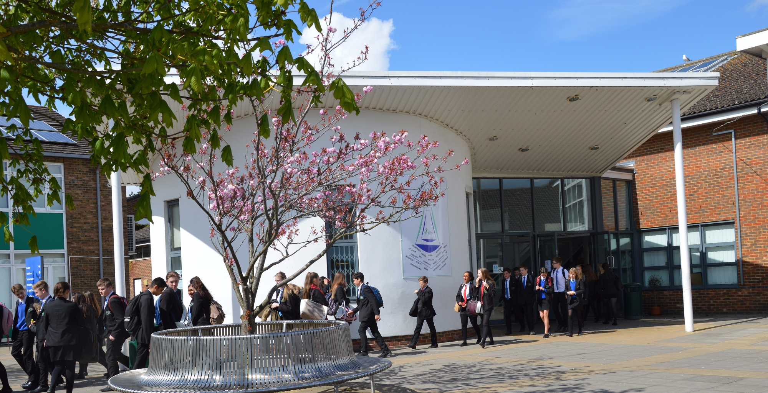
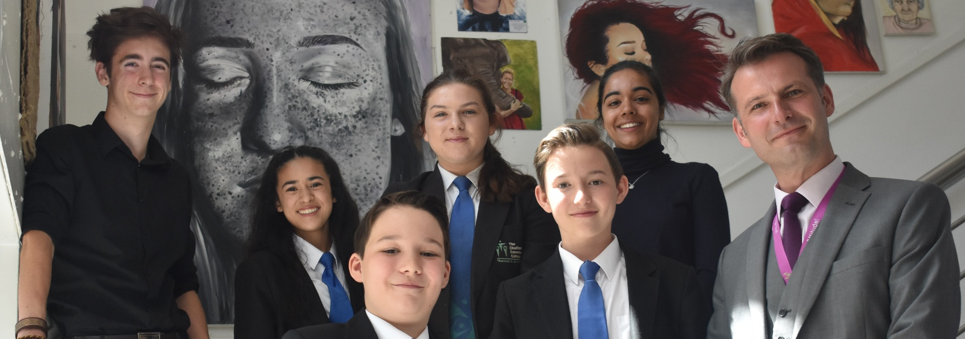
Thank You
Meet your child’s form tutor
Meet our Senior Leadership Team
Talk to our students
Uniform sale

